Slide 1
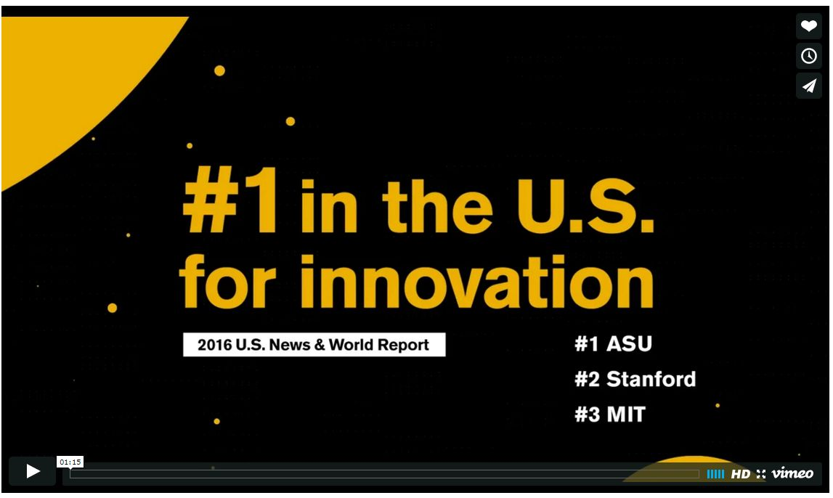
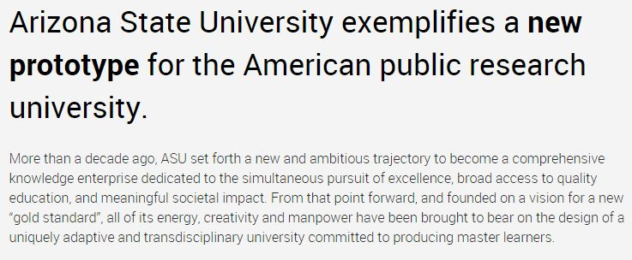
Computational Physics:
- A Model for Physics Education
A Model for Future eTextBook
© Rubin Landau, OSU
Notes:
Jill biden, wife of VP, BACH & PHd udELL
Craig Robertson, brother of 1st lady, OSU BB coach

Slide 2




Computational Physics:
- A Model for Physics Education
A Model for Future eTextBook
Rubin Landau
Physics Professor Emeritus
Oregon State University
physics.oregonstate.edu/~rubin
1st = Computational subatomic few-body systems (1966-2003)
2nd = Research developments (1988-) → broaden, ed dream
Computational Physics for Undergraduates
Supported by NSF (CCLI, CI-Team/EPIC), OSU, MSR
© Rubin Landau, OSU
Notes:
Jill biden, wife of VP, BACH & PHd udELL
Craig Robertson, brother of 1st lady, OSU BB coach

Slide 3

Contributing Group
Manuel J Paez, University of Medellin, Colombia, SA, CoAuthor
Cristian Bordeianu, University of Bucharest, Romania, CoAuthor [deceased]
Paul Fink, Robyn Wangberg, CoAuthors
Justin Elser, Chris Sullivan (system support)
Sally Haerer, Saturo S. Kano (consultants, producers)
Melanie Johnson (Unix Tutorials)
Hans Kowallik (Computational Physics text, sounds, codes, LAPACK, PVM)
Matthew Ervin Des Voigne (tutorials)
Bertrand Laubsch (Java sound, decay simulation)
Jon J Maestri (vizualizations, animations, quantum packets) [deceased]
Al Stetz, David McIntyre (First Course)
Juan Vanegas (OpenDX)
Connelly Barnes (OOP, PtPlot)
Phil Carter, Donna Hertel (MPI)
Zlatko Dimcovic (Wavelets, Java I/O)
Joel Wetzel (figures)
Pat Cannan, Don Corliss, Corvallis High School (N-D Newton Raphson)
Brian Schlatter
Daniel Moore, (REU, Summer 98; Whitman College, WA)
Justin Murray, (REU, Summer 98; Weber State University, Ogden, Utah
Brandon Smith, (REU, Summer 97; Chico State/SDSC, CA)
Paul D. Hillard, III (REU, Summer 96; Southern Univ, LA)
Kevin Wolver, (REU, Summer 96; St Ambrose, IA)
And all the suffering students!
© Rubin Landau, OSU

Slide 4
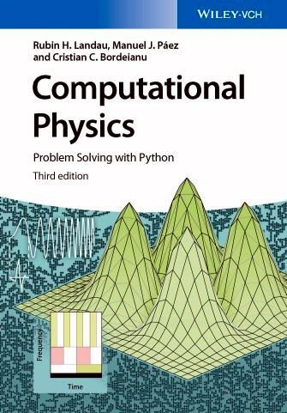
Preview (CP-2 Resource Letter, AJP)
D of SC
Need Comp Science & Engr (CSE data) √
Computational Courses √
Comp Physics Approach & Contents √
Journals
Conferences & Organizations
  b. SC Center & Grids
  c. CSE Ed Focus Groups √
Books √
Tools, Languages, Environments √
Parallel Computing
Digital Libraries, eTexts √
  Subroutine libes
  General DLs
Python Version
Wiley 2015
© Rubin Landau, OSU

Slide 5
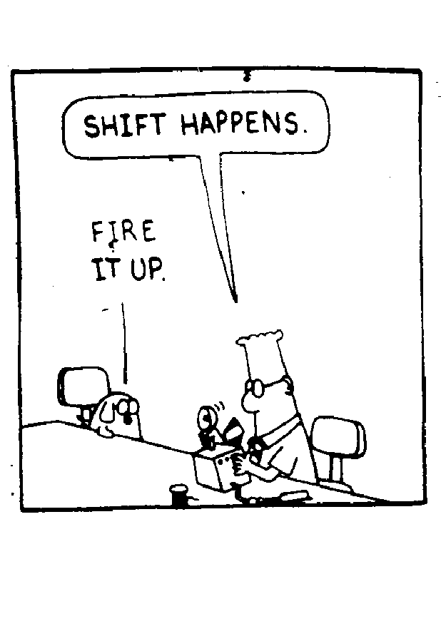
Time to Change the Status Quo?
If work paradigm changes, education paradigm changes. Steve Stevenson
… the greatest thing a human soul ever does in this world is to see something, and tell what it saw in a plain way. Hundreds of people can talk for one who can think, but thousands can think for one who can see. John Ruskin
You never change something by fighting the existing reality. To change something, build a new model that makes the existing model obsolete. (moving cemetary)
Buckminster Fuller (Bernie? )

Slide 6
Premise: Need Δ (Phys Ed)
Historical rapid Δ in how/what do science
  ⇑ computer power & pervasiveness
⇒ Δ undergrad Physics Ed > delivery (C tool)
  Proper for P Ed Δ content: more C, Understand C
  CSE view; Toolset freedom, Compt Science Think
Physics Choice: like Classic Greek, or living?
  “we are teaching the same things we taught 50 years ago” (APS/AAPT Taskforce on Grad Ed., R Diehl)
RHL: PH(t) narrows; + Fluids, MD, NonLinear, data mining
Simulation: Solitons, QCD, Stars, Black holes, Particle-Astro

Slide 7
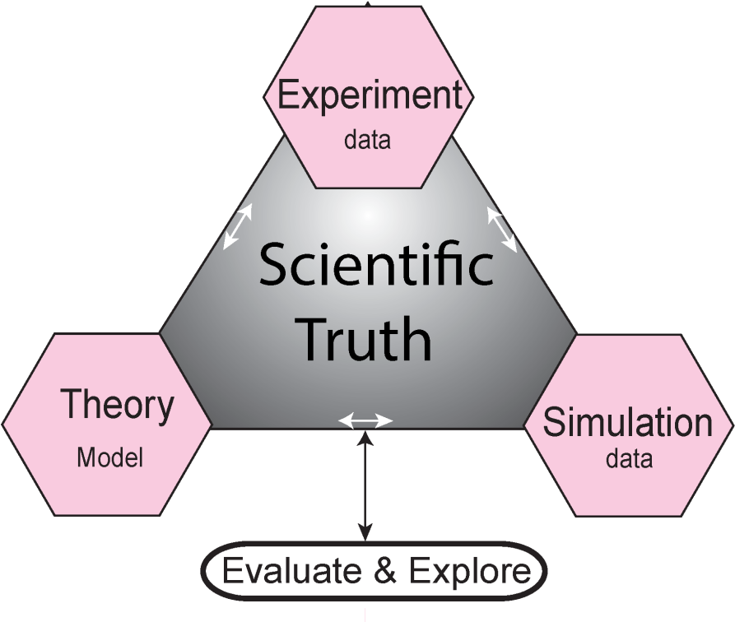
Premise (cont): Need Δ (Phys Ed)
Physics = problem solving describing physical world
From Basic principles + math tools
Now + Computation = tool
National Labs Research → CSE
Computational Phys Ed view
  ⇔ research (creative) = Hi Quality education (USNWR)
  = Physics Education + research attitude & tools
    ≠ Physics Education Research (inward)

Slide 8
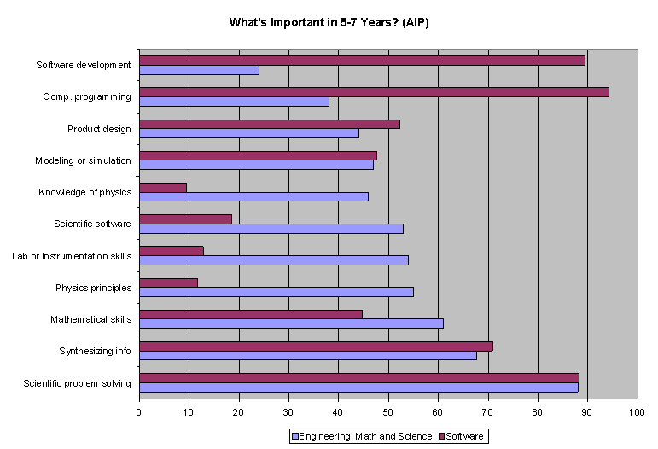
Evidence for ∆ (Physics Ed) 1
Software
S, M, E

Slide 9
Evidence for Δ (Physics Ed) 2
National Science Board: remain in field
  35% of CS, math BS (74% PhD)
  22% of physical, biological (52%)
  ≠ bad thing!
⇒ Undergrad Physics overemphasize Physics!
    = weaker preparation for career
  “In the new economy, computer science isn't an optional skill“ B. Obama, 2016

Slide 10
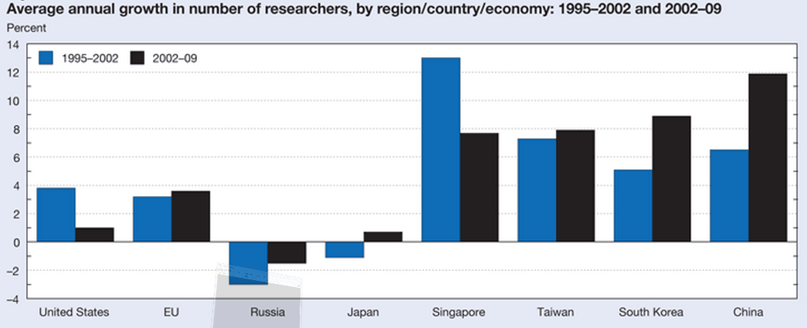
Evidence for Δ (Physics Ed) 3
US Natl Science Board: remain in field
  35% of CS, math BS (74% PhD)
  22% of physical, biological (52% PhD)
  ≠ bad thing!
⇒ UG P overemphasize P = weaker prep.
Number US STEM grads decreasing
Yet Numb ≠ issue!, t_{HW}=24hr (1961) ⟶ 15 hr
Bristol Comp Ph Exam: 75% (1990) ⟶ 50% (2000)
Though entrance grades increased (B ⟶ A)
NSF 2012

Slide 11
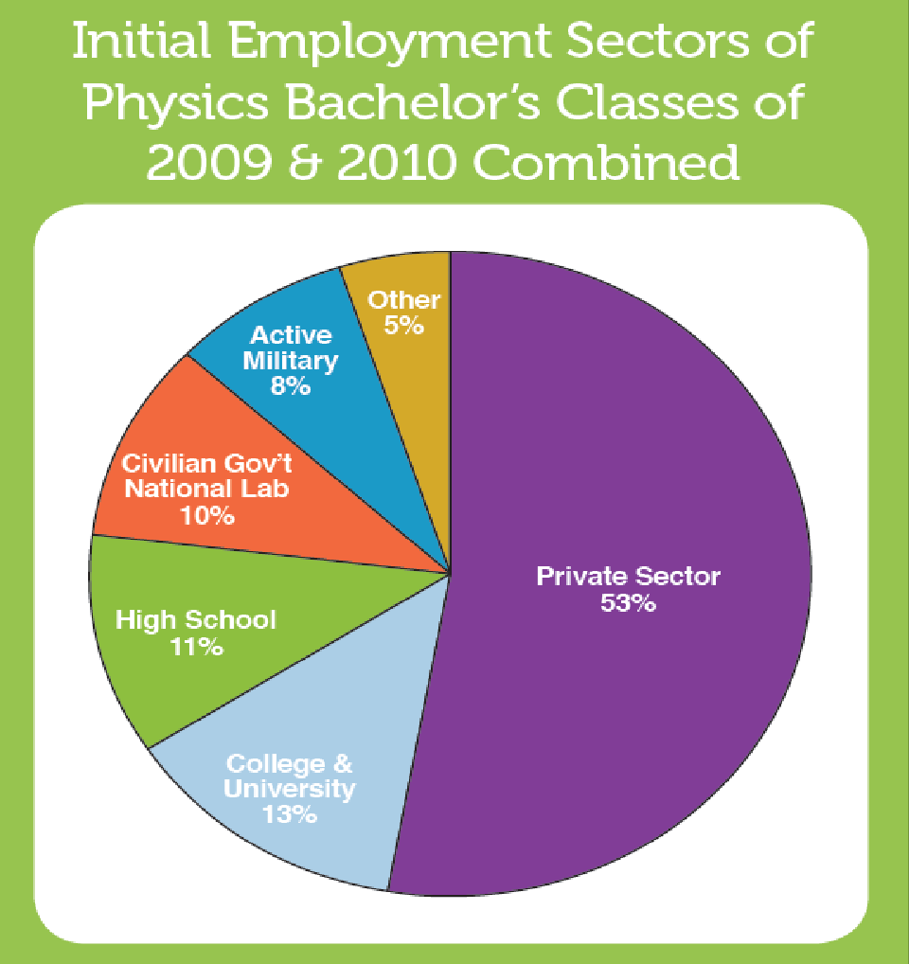
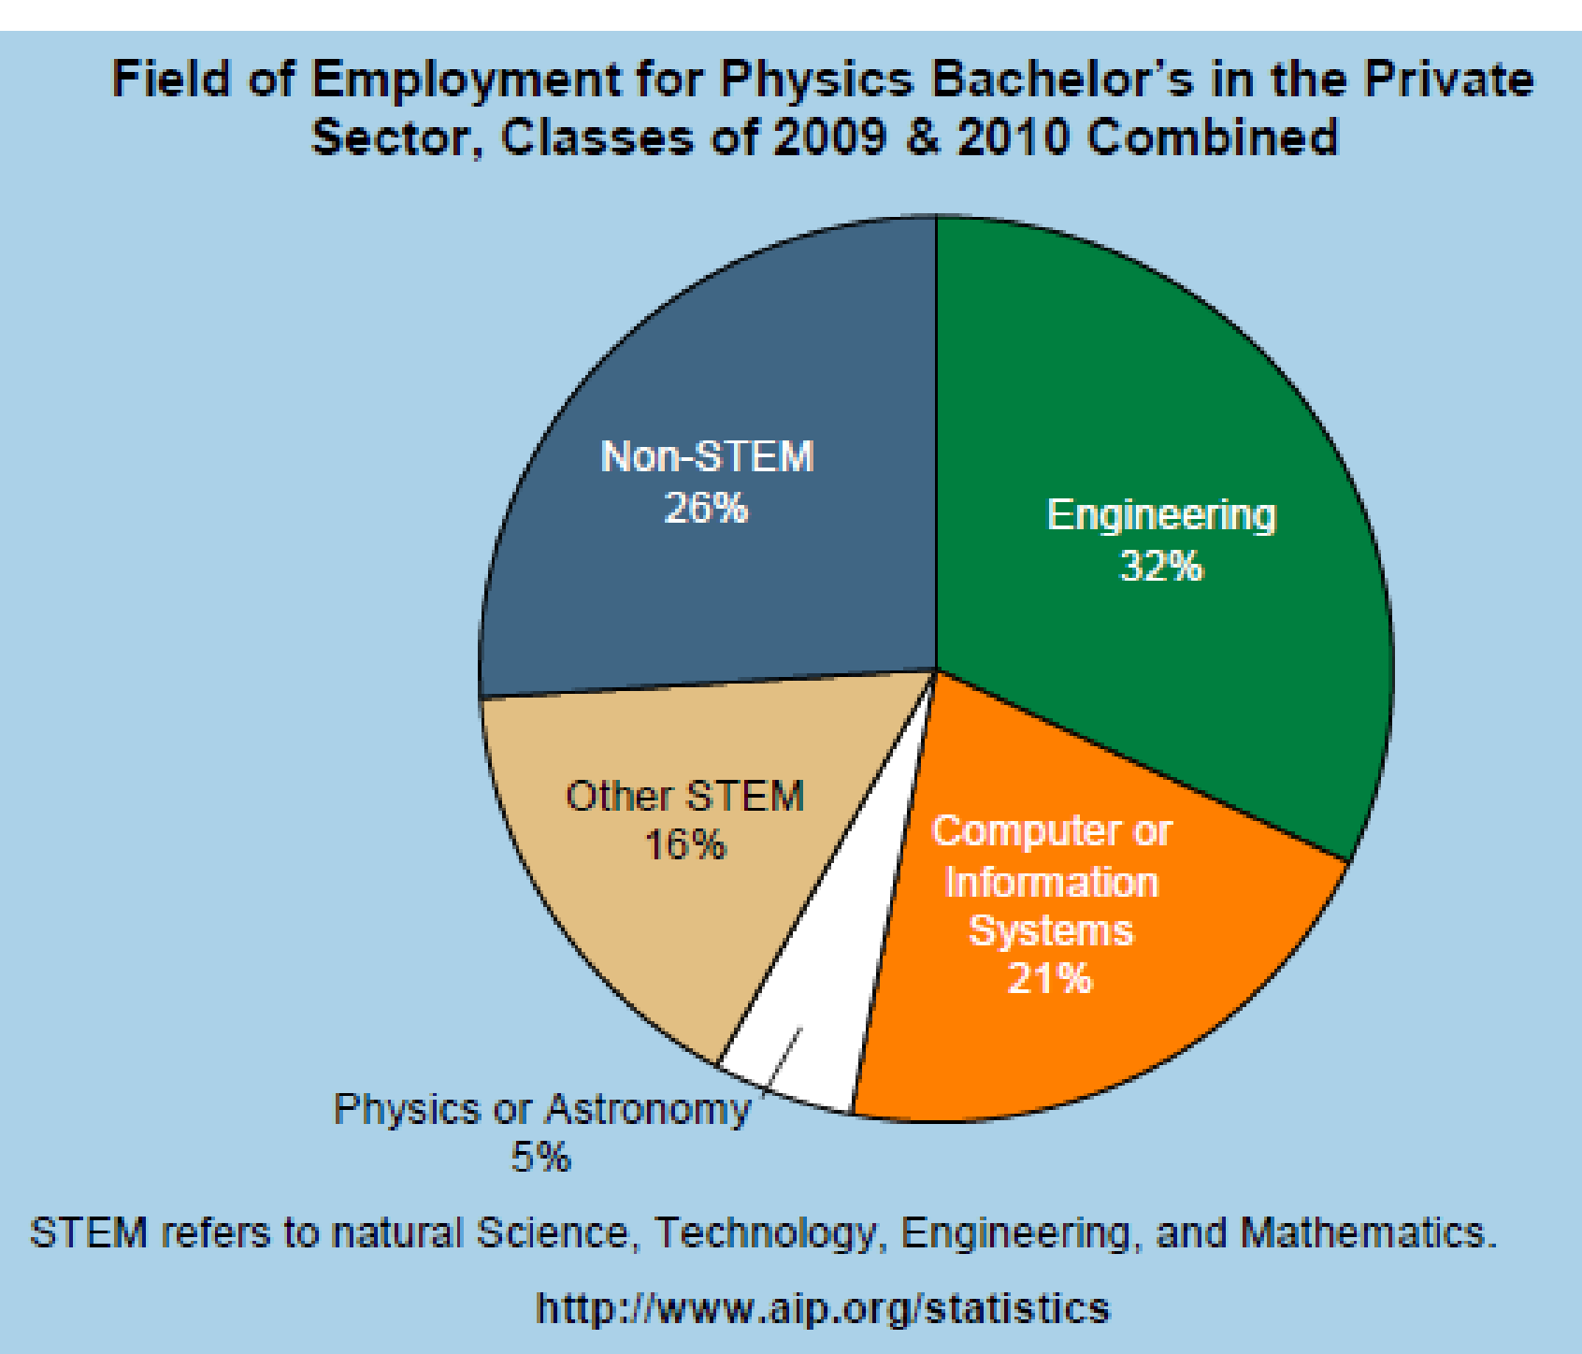
Evidence for Δ (Physics Ed) 4
Where Do Physics BS's Go?

Slide 12
Evidence for ∆ (Science Ed)
RHL Survey (Y&L)
CSE, CP ~ balance
Small sample
Stereotypes 
PH Ed:  imbalance?
O
t
h
e
r
P
H
Y
S
M
T
H
C
S

Slide 13
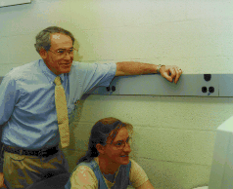
What, How = CP Education?
Problem solving (why do P, what P do)
Education: Learn by doing individual Projects
Over-shoulder teach (lectures?)
Practical ≠ “Theory of CP” (grad, math); doers
CS + Math + physics in context
More efficient, effective approach to science Ed
  ok ↓ # “physics” hours
Compiled language
  see algorithm (eqtns)
  bare bone codes given
  “I am not a bigot!” (Python, packages)
Multi ≠ Inter
O.Y.

Slide 14
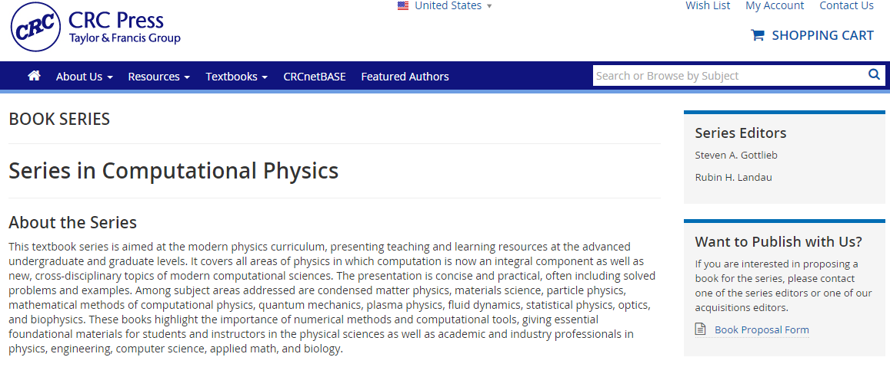
Help Us Change Physics Courses
President’s Info Tech Advisory Committee:
  CS departments alone can’t meet need, not diverse,
  “computational science indispensable in every sector,… need be recognized by governments & universities”
We want your course as a text

Slide 15
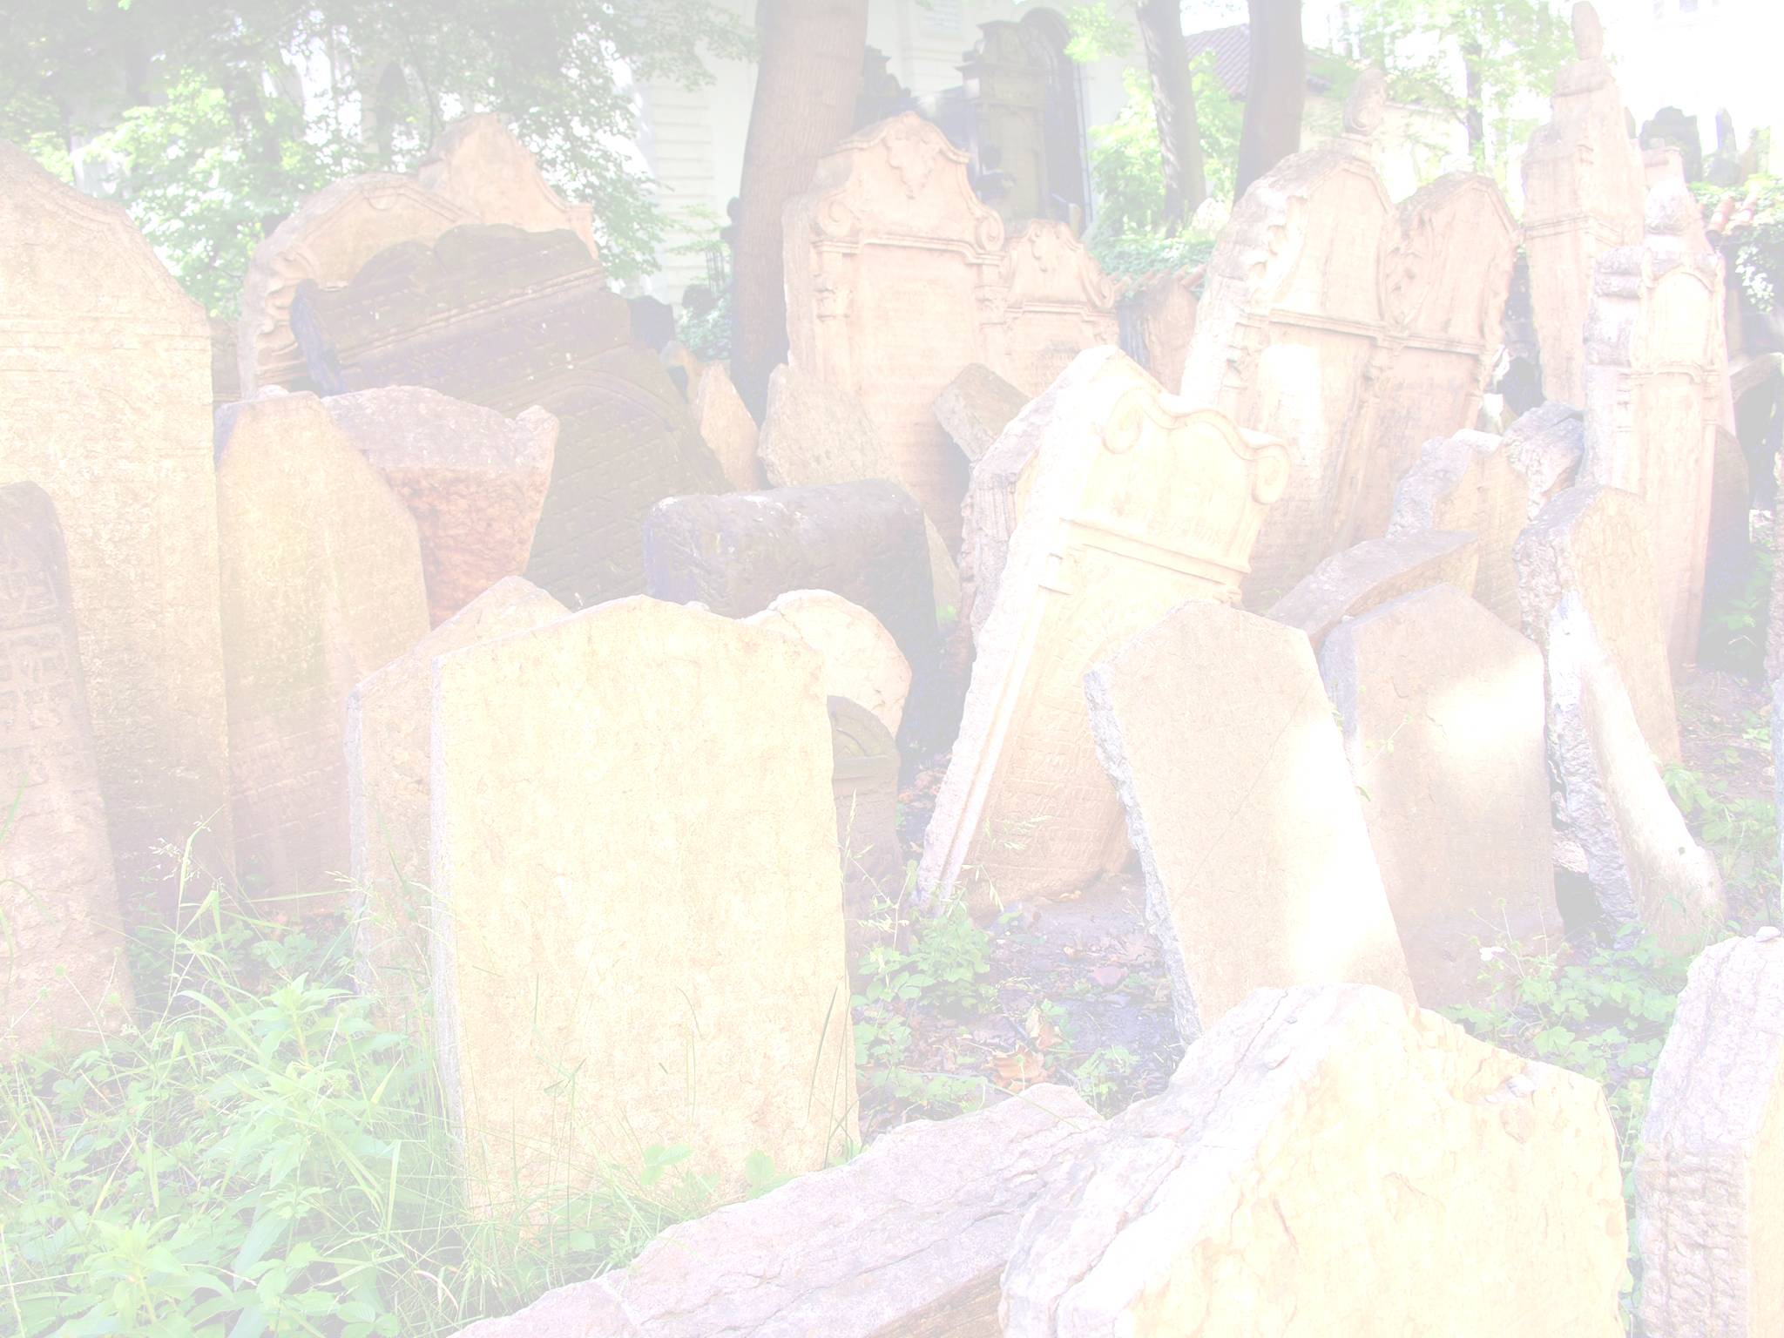

BS in CP @ OSU
Real computation across the curriculum
Not 1 course, not just our view
Use Available & New Courses < 7 years
Dual degrees

Slide 16
Computational UG Degree
Abbassi, Swanson, Epic, Mariasingam, L
≈ 5x(2001)
Computational Physics | Computational Mathematics
1. Houghton C | 1. Arizona State
2. Illinois State | 2. CUNY Brooklyn
3. Oregon State | 3. Michigan State
4. SUNY Buffalo | 4. Missouri So State
5. Chris Newport (BS/MS+CS) | 5. Rice
Computational Science | 6. Rochester Inst Tech
1. Stanford (+Math) | 7. Seattle Pacific
2. SUNY Brockport | 8. Saginaw Valley State
3. Stevens Inst Tech | 9. San Jose State
4. UC Berkeley | 10. U Chicago
Computational Biology | 11. U Illinois Chicago
1. Carnegie Mellon
2. U Pennsylvania
Foreign | Programs
1. Australian National University | 5. 6. U Calgary (CSE) , Waterloo
2. Kanazawawa U Japan (CSE) | 7. U Erlangen-Nurnberg (CSE)
3. National U Singapore (CSE) | 8. U Waterloo (CSE)
4. Trinity C, Dublin (CP) | 9. Utrecht U (CSE)

Slide 17

Other UG Computational Programs
What's in a name? That which we call a rose by any other name would smell as sweet.
Minor, Concentration, Track, Emphasis,
Option, Focus (23) (all politics are local)
Computational Physics | Computational Science
1. Carnegie-Mellon, 2. Abilene Christian | 1. Capital
3. North Carolina State, Chapman | 2. Clark
4. Penn State Erie | 3. Old Dominion
5. U Arkansas | 4. RPI
Computational Mathematics | 5. Salve Regina
1. Princeton (App & CM) | 6. Syracuse
2. San Diego State (App & CM) | 7. U Wisconsin Eau Claire
3. U Central Florida | 8. U Wisconsin LaCrosse
4. U Nebraska-Lincoln | 9. U Wisconsin Madison
Computational Biology | 10. Wittenberg
1. UC Merced | 11. Wofford C
2. Center CB (Colo)
(NY Botanical)

Slide 18
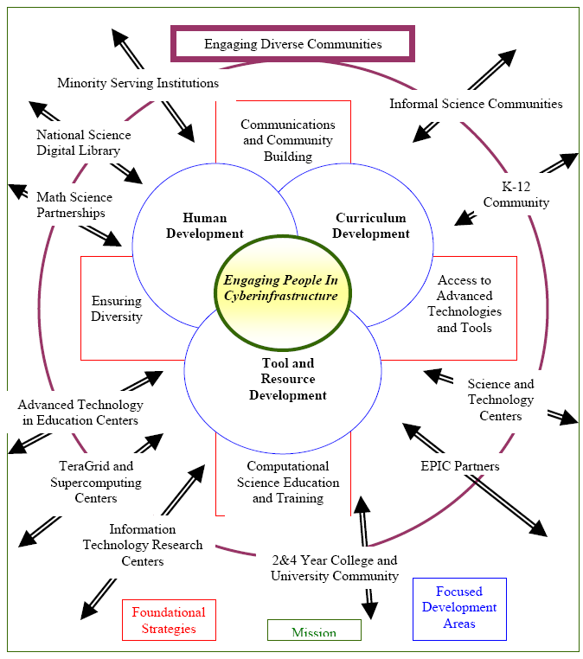
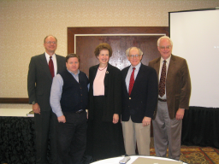
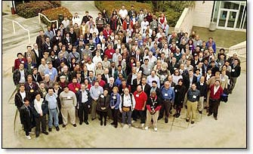
It Takes a Village
C
S
E
C
O
M
M
U
N
I
T
y
DOE Awards, Fellowship
XSEDE (NSF)
(Extreme Sci & Engr Discovery Environ)
= S SuperComputer Centers
Education People

Slide 19
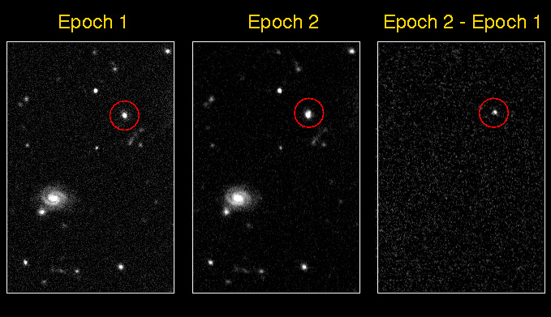
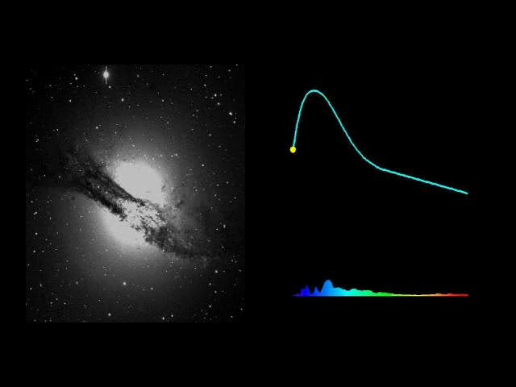
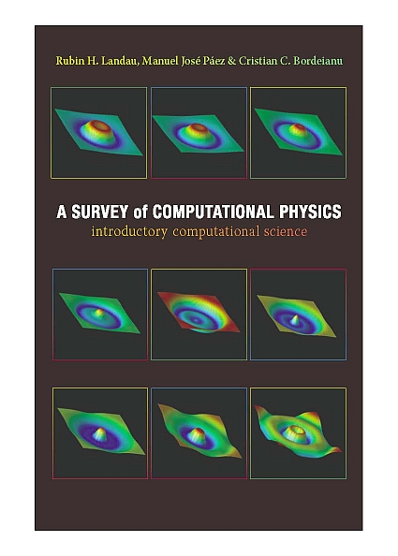
CP is Research, eg Supernova on Demand
Particle physicists data-intensive computing meets astronomy
Measure: expansion rate of universe via Type Ia supernovae
  standard candle, 2-pt correlation function
Movie ↓
Nat Roe: Physics student coding
  Poor documentation
  Poor structure
Notes:
Supernova
last 10 years revolution in astrony, Sloan Digital Sky Survey
LBL, computational intensive, Noble Prize Work
2-point correlation function S(x,y) = <f(i,j) f(i+x,j+y)>
type 1A Supernova => speed up expansion universe, info dark energy (73%)
May 2008 (NSCSU) found youngest in milky way galaxy: <140 yrs (prev 340)
see rock making splash, not just waves in the pond
2007 X-ray telescope vs 1985 radio telescope (not visible optically)
16% increase in size during 22 years => 100 years old
massive star collapse, core shines bright, explodes leave n star/black hole
produces heavier elements of universe
50-100 galaxies/field view; 12 SN discovered while brightening

Slide 20
Intellectual Content Computational Physics Ed
Elements of Computational Science & Engineering Ed, Yasar & L (SIAM)
Prerequisite establish Computational Physics course
Include CP Examples in classes
Easy (too) expect 1 course teach entire subject (programming?)
Historically guided by research needs; grad study = easy
See Student Learning Outcomes (AIP) for specific subjects
≠ , don’t need CP BS, 7 years
Don’t have to buy entire curriculum, all politics local

Slide 21
Examples for Physics Courses
Spontaneous Decay Simulation Classical Chaotic Scattering Proper ODE Solution Double & Chaotic Pendula Nonlinear Dynamics, Bifurcation Fractals & Statistical Growth Laplace & Possion Equations Realistic PDE Solutions Molecular Dynamics Quantum Wave Packets | Realistic Waves Shock Waves Solitons Sonifications Fluid Dynamics DFT, Wavelet Analysis Feynman Path Integrals Wavelet Analysis Prin Component Analysis Data Intensive

Slide 22
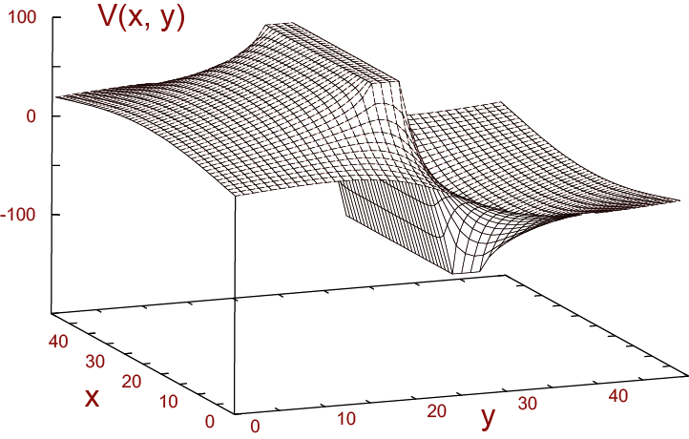
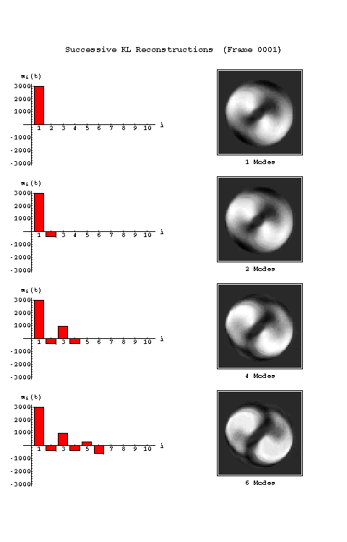
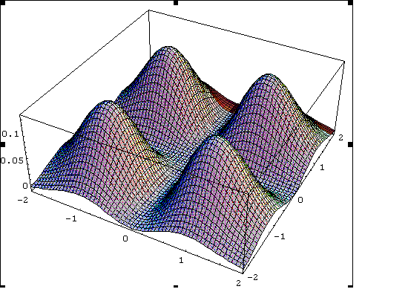
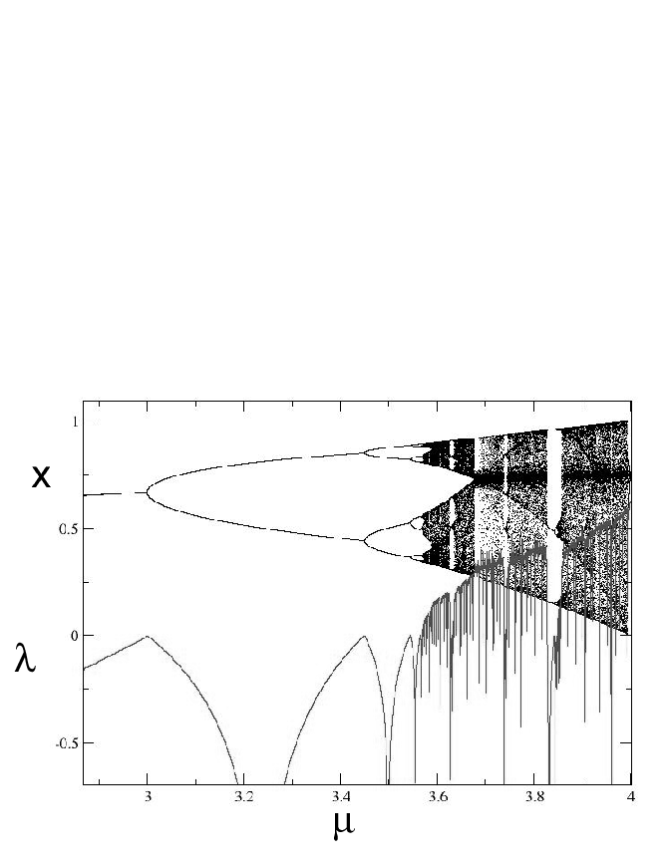
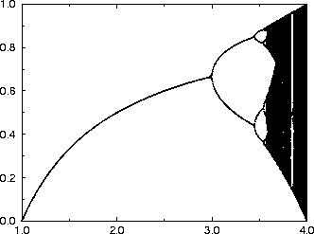
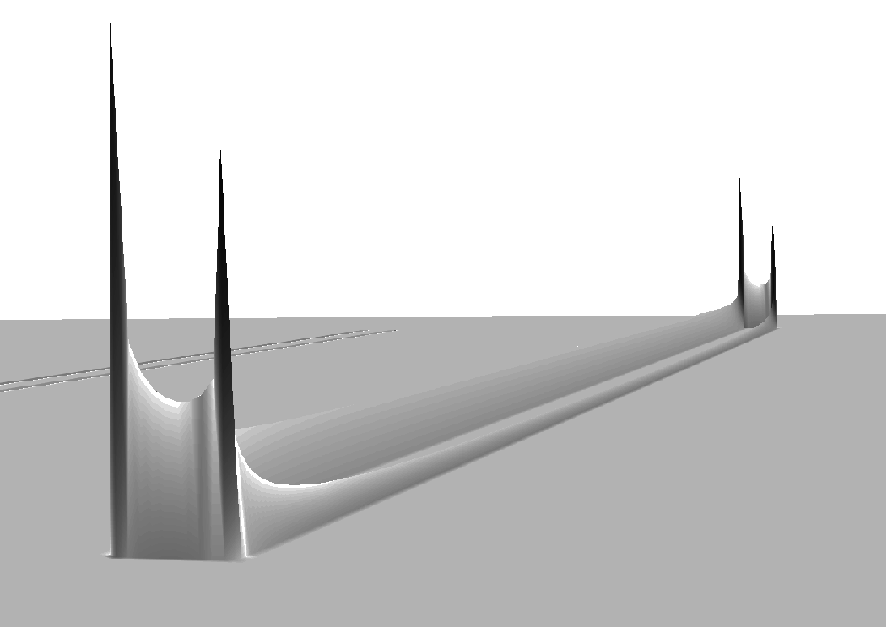
How Does this Work?
Challenging for some students (intro*, multidisciplinary)
Unhappy with grade if just ran code, no thought, no time
Students often thankful when/that over (career)
Tears, excitement; human-C interaction = complex
“This combo is what I interested in, but had to pick 1”
“Why have we studied fluids only in our freshman year?”
“Now I know what is dynamic in thermodynamics” ↓↑↑↓
“Now Laplace’s equation makes sense”
“I was up all night.”
Chaotic scattering: several MS, 1 Ph D thesis
“Molecular Dynam: way I thought simulations should be”
Great prep  physics, astroP, CS, ocean, bioP, brain
Women: didn’t know liked C, problem solving
ρ

Slide 23
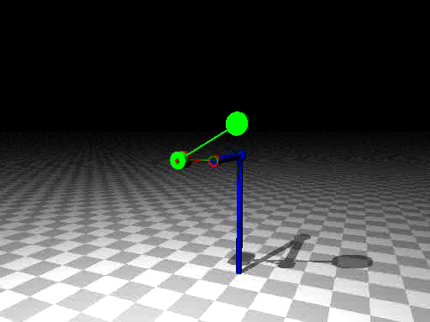
Double Pendulum

Slide 24
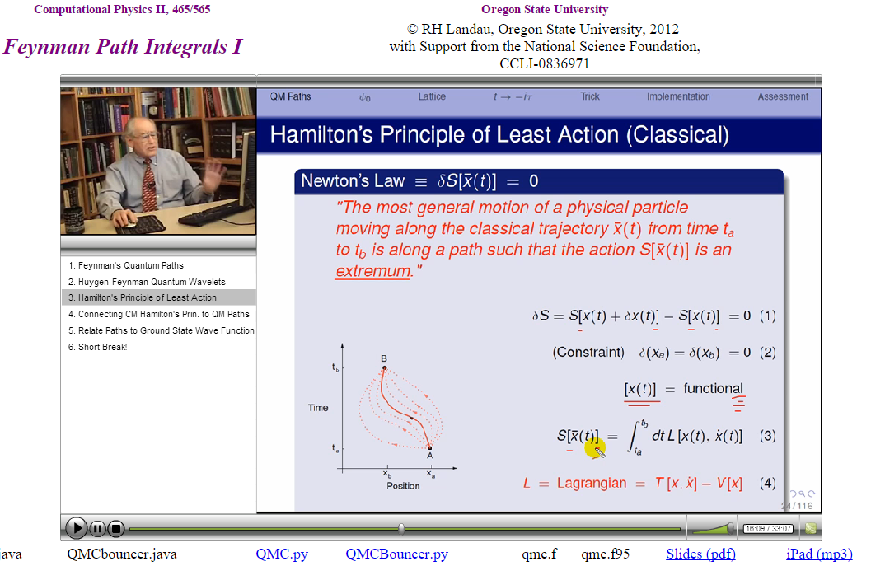
Online Education
Web N^{th} gen is here to stay & grow
Challenge use it well for Education
RHL: Not for general ed, weak discipline, motivation
Natural (best) for computing education
Good pedagogy trumps media
Free Online
Lecture and Slides
(N-D Search)
RHL: Hybrid Course
Online Lectures
Lecture time → Lab time
Dynamic slide
Dynamic
TOC

Slide 25
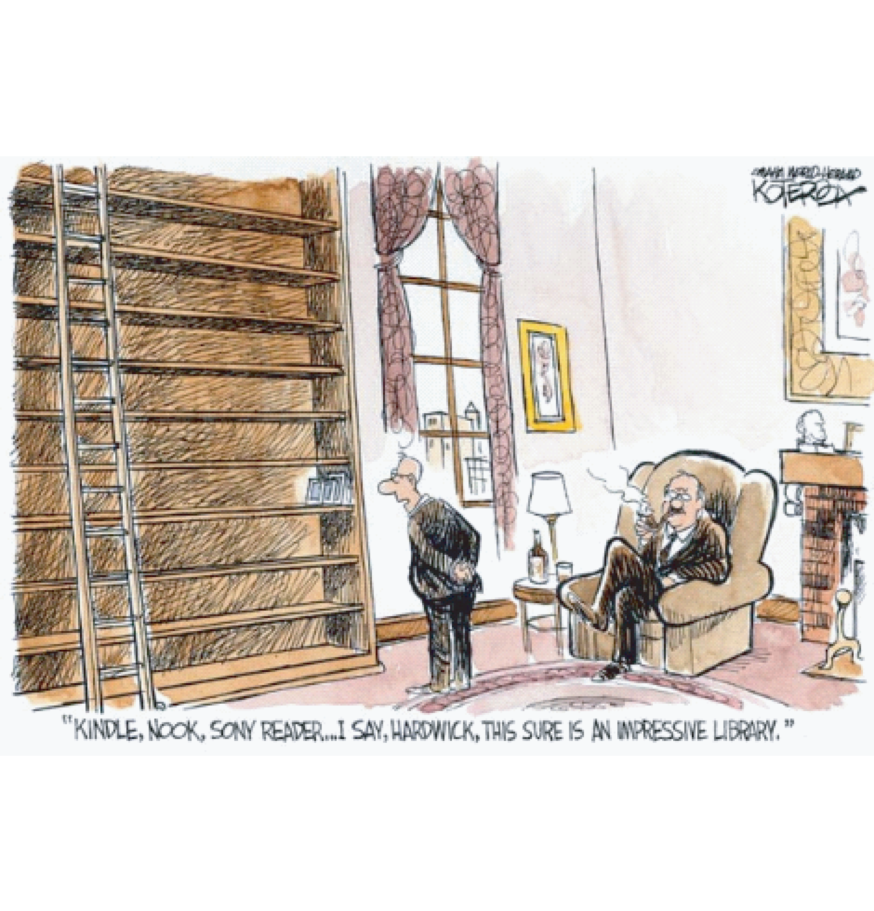
Digital Book

Slide 26

Digital Book
(link)
Technology Catching Up
Exploring since 1996 WWW
Multiple senses
High accessibility potential (ADA)
∆ learning approaches
Students: integrated package
Interactive eqns, figs, codes
Html1, Java Applets, XML, ePub, Ibook, Kindle, Pdf-href, Html5, ipynb
Python notebook (TOC -8 euler, abm) ~rubin/Books/CPbook/eBook/Notebooks
Not There Yet
Exec “paper”, OS’s incompatible
Security concerns
Very large files (→ cloud)
Validate data & codes?
No standard readers, writers
≠ deep subject mastery
Mastery >> scanning
No page numbers
A good book has no ending. –R.D. Cumming

Slide 27
Take Home Lessons
Physics now done with computation
Physics now done with other sciences
Physics Ed now done with 50-100 year old stuff
Students are people; more product than customer
Agree: bad math means unreliable science?
So bad computation means unreliable science
Computation too important to leave to CS

Slide 28
Conclusions & Summary
Suggest: rejuvenate Phys Ed with modern Res (+CP)
Need Δ curriculum: learn P + CS + math in context
CP courses, materials: More efficient, effective Model
  learning within problem solving, emotional connect
  learn all 3 better, frees t for C, M
  Freedom: common toolset & mindset CSE
  Thank you! Let me know if I can help.
  www.science.oregonstate.edu/˜rubin

Slide 29
Skills Expected of Physics UnderGraduates (AAPT)
Plot functions and data
Visualization complex data
Numerical integration, diff
Limits of algorithms
Programming*, compiled
language
Several operating system
ODEs, PDEs
Matrix operations
Fourier transforms, FFT
Statistics, data fitting
Computational thinking
Symbolic programming
LATEX

Slide 30
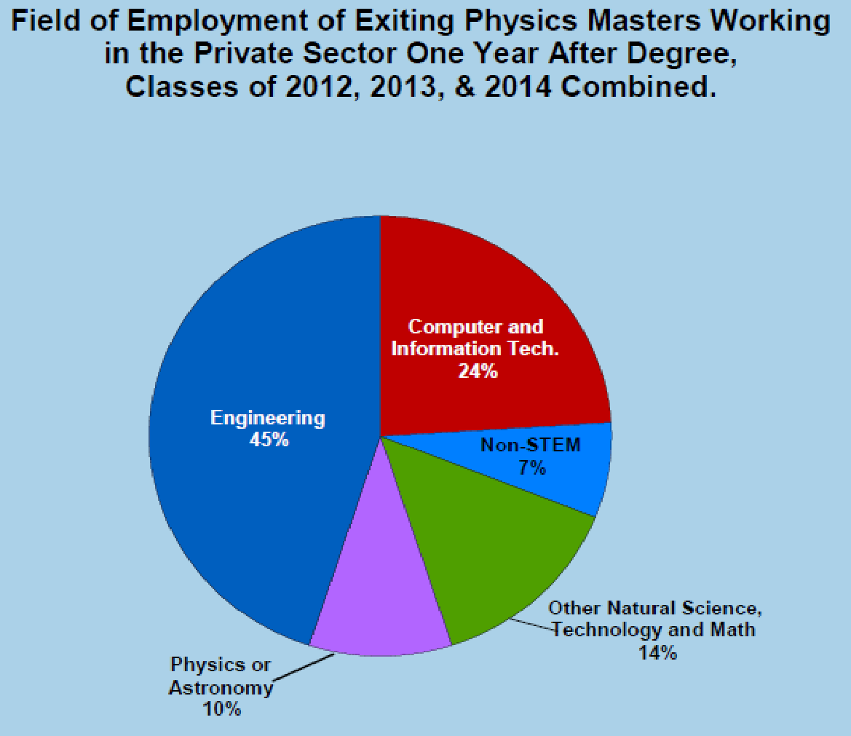
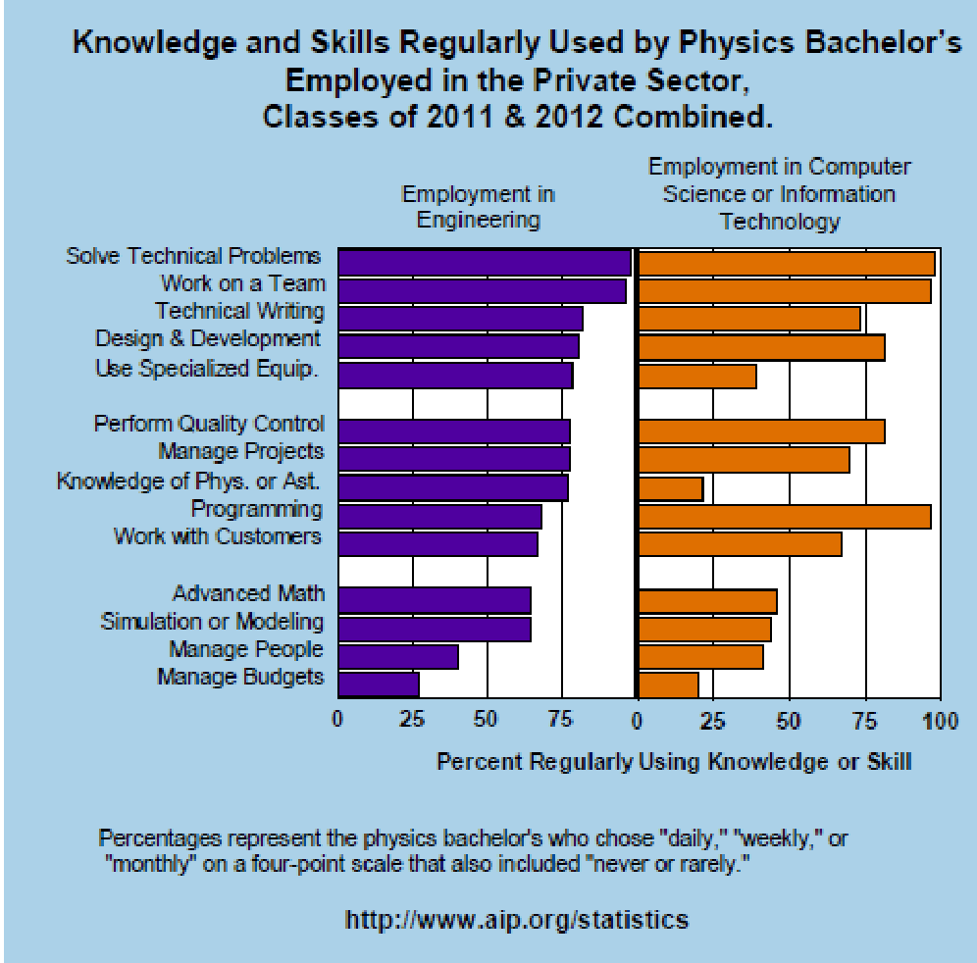
Evidence for Δ (Physics Ed) 5

Slide 31
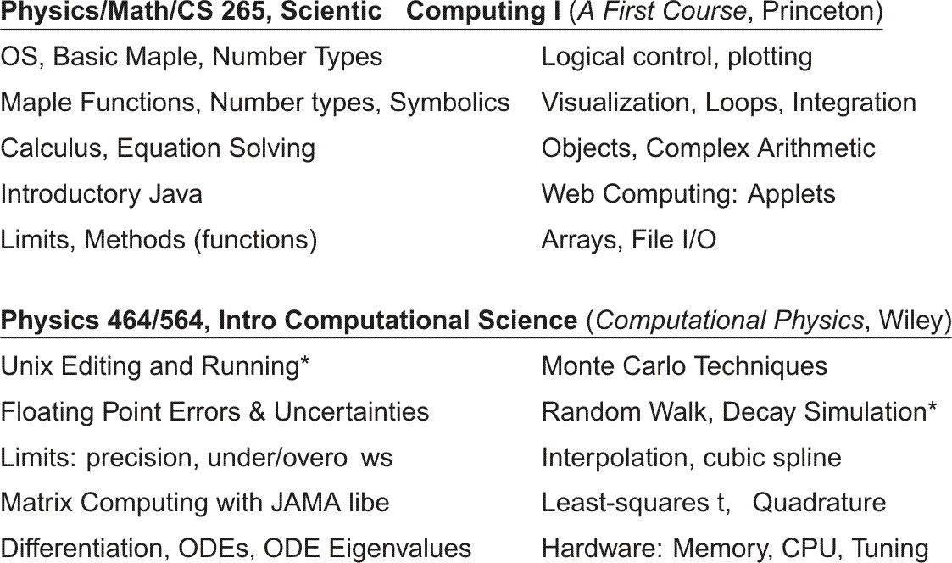
Two Lower-Division Courses

Slide 32
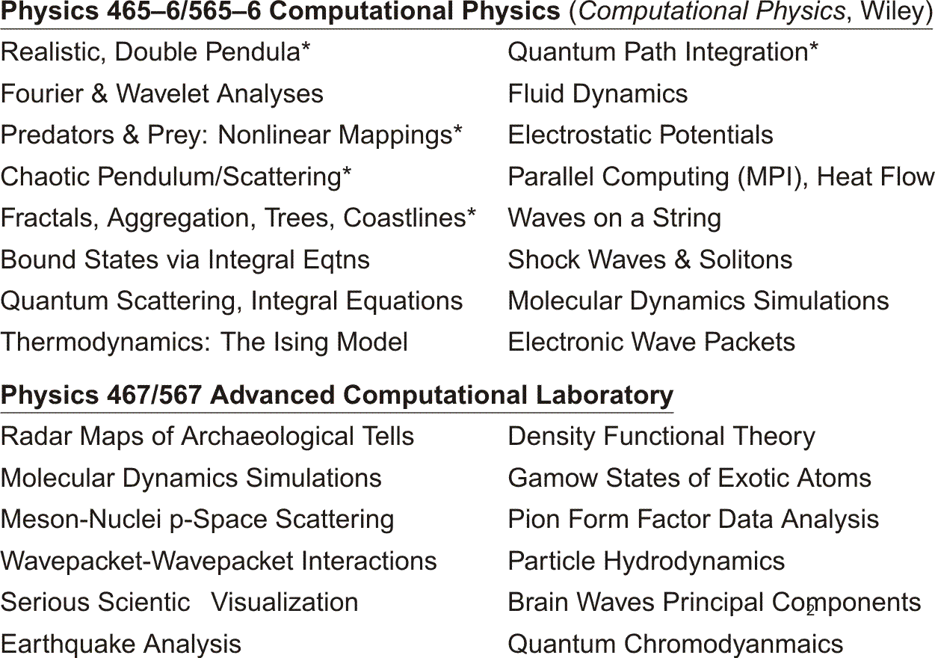
Contents of Upper-Division Courses

