Slide 1
pagone@uchicago.edu
Physics: Preparing now for a prosperous future
PH199, Oregon State University
Agenda:
Get your name badges now.
Intro to Scholarships & Research in Physics.
Some career-focused statistics
External research and scholarships
3) Guest: Claire Wu, CoS Career Development Services Full work class workshop!

Slide 2
What is a REU?
Research Experiences for Undergrads (REU)
Funded by National Science Foundation (NSF)
Only available to citizens/nationals of USA
Cutting edge summer research at universities and institutes– often ~ 10 students per program
Many, many fields of research available
Housing and modest stipend provided
Acceptance can be competitive

Slide 3
What kinds of REU’s are there?
Dozens of fields, 100’s of individual programs and universities, every state
See NSF site: http://www.nsf.gov/crssprgm/reu/reu_search.cfm
Lots and lots of areas in pure physics, but don’t constrain yourself!
Physics qualifies you to do more than you might imagine
Go for what you find interesting in a place you would like to be for the summer

Slide 4
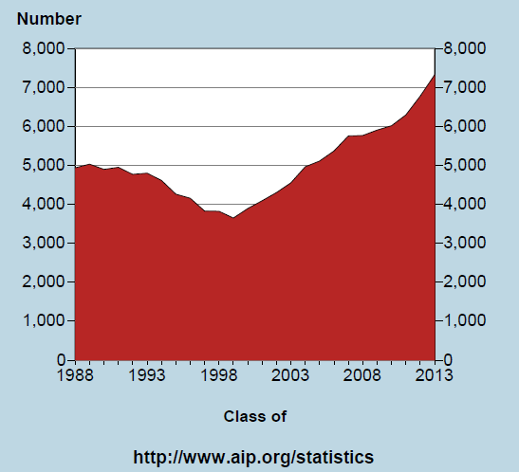
Data. How many?
Physics bachelor’s degree production is on the rise.

Slide 5
The “typical” physics major - STATS
Among those who earn physics bachelor’s degrees
~3/4 have research experience!!!
~1/3 graduate with a double major, many in math.
1/10 started at a two-year colleges.

Slide 6
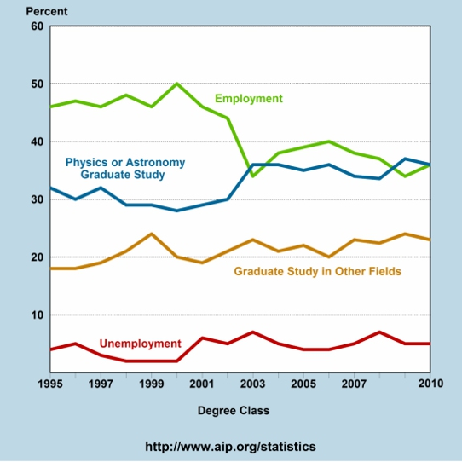
One year lAter
Notes:
With an average 40\% of all physics baccalaureate degree recipients opting not to enter graduate school, it is a question worth considering for departments aiming to build robust programs that prepare students for a broad range of career paths.
What if a student expresses a desire to enter the workforce upon completion of the bachelor's degree?

Slide 7
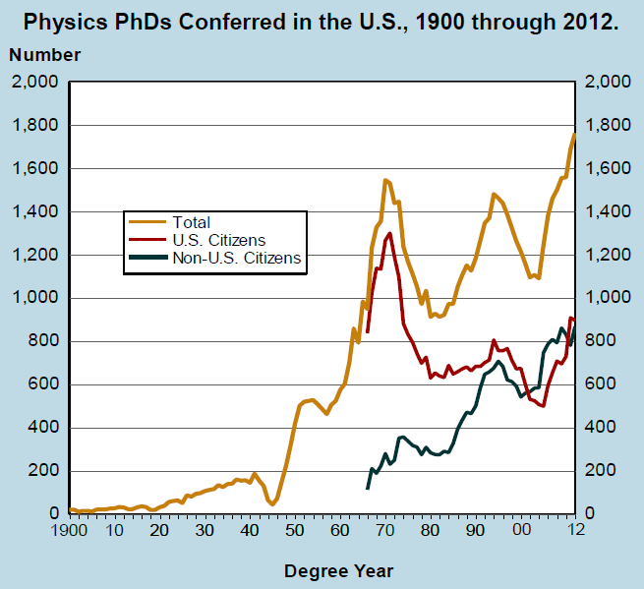
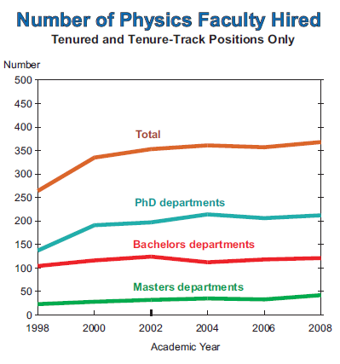
What about a PhD?
So up to 1 in 10 PhD graduates will become a physics professor at research university.
October 2009

Slide 8
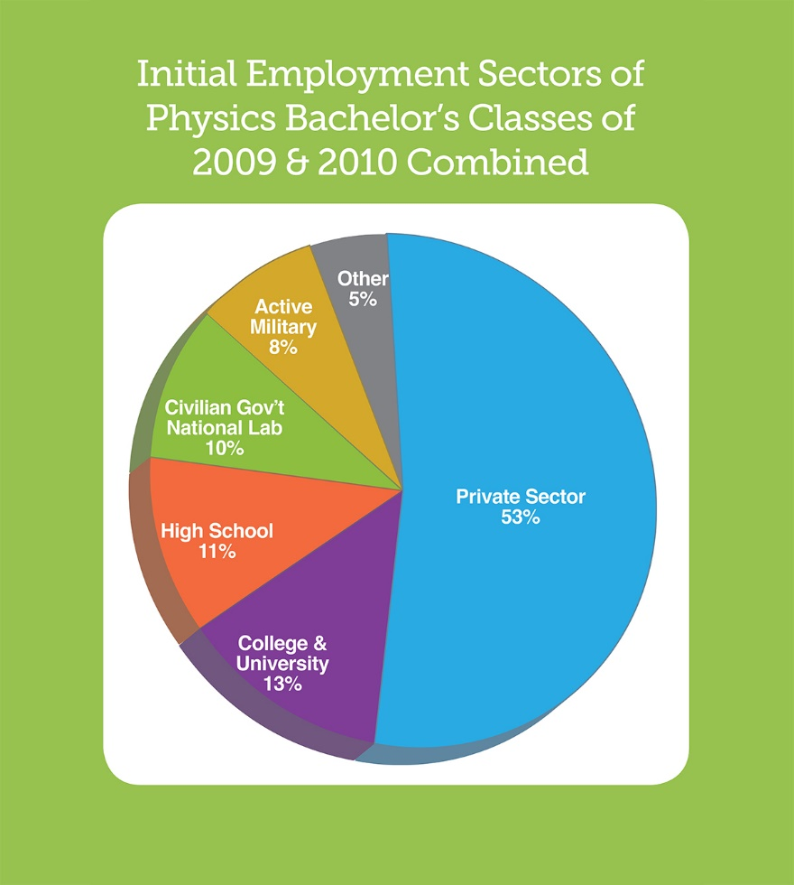
Let’s zoom in

Slide 9
Students should be equipped for the path they choose when they complete their
bachelor’s degree. Any path!
Workforce (STEM, non-STEM)
Grad School
(Physics & other)
Teaching K-12

Slide 10
SCHOLARSHIP ADVICE
199 Webpage:
Week 2 Links: Applications Applying for Scholarships/Internships/Jobs COS Scholarships COS Scholarship Advice SPS National Scholarships URSA Engage SURE Science mid-March Science Professional Pursuits Program Glossary Letters of Recommendation Personal Essays Timeline Letters APS Jobs Powerpoint [Physics Internal Link & Document Provided by Courtesy from Prof. Corinne Manogue]
Notes:
With an average 40\% of all physics baccalaureate degree recipients opting not to enter graduate school, it is a question worth considering for departments aiming to build robust programs that prepare students for a broad range of career paths.
What if a student expresses a desire to enter the workforce upon completion of the bachelor's degree?

Slide 11
Other Smaller Programs
HHMI Janelia Farms is a very elite summer program (they like physicistshttps://www.janelia.org/you-janelia/students-postdocs/undergraduate-scholars-program
DAAD: Research exchange in Germany https://www.daad.org/en/find-funding/undergraduate-opportunities/undergraduate-scholarship/
Don’t forget about DOE’s Undergraduate program at National Labs http://science.energy.gov/wdts/suli/
Research in Israel, Weizmann Institute Summer School https://www.weizmann.ac.il/feinberg/admissions/kupcinet-getz-international-summer-school/about-program-0
Astrophysics: spend the summer at the Vatican Observatory with the Pope http://www.vaticanobservatory.va/content/specolavaticana/en/summer-schools--voss-/voss2018.html

Slide 12
Resource Links: Take with a tsp of salt
Advice on admissions, selections, and graduate life:
http://cosmicvariance.com/2005/12/20/unsolicited-advice-1-how-to-get-into-graduate-school/
http://graduate-school.phds.org/
http://www.cs.unc.edu/~azuma/hitch4.html
http://www.physlink.com/Education/GradAdvisor.cfm
Graduate program rankings:
http://www.petersons.com
http://www.gradschools.com/
http://www.princetonreview.com/grad/
http://www.gradschooltips.com/
http://grad-schools.usnews.rankingsandreviews.com/usnews/edu/grad/rankings/rankindex_brief.php
GRE information:
www.ets.org/gre/
http://www.physicsgre.com/

