Slide 1
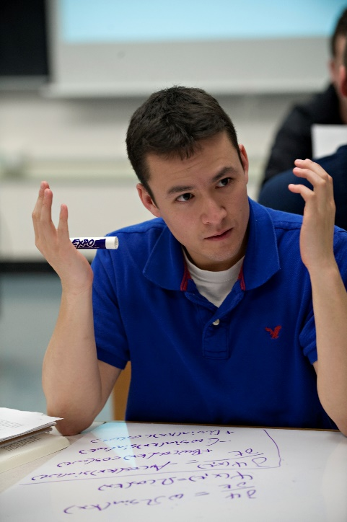
Paradigms 2.0
Designing a New Curriculum
Corinne Manogue
and the whole
Paradigms Team

Slide 2





Support
National Science Foundation
  DUE-9653250, 0231194, 0618877
  DUE-0837829, 1023120, 1323800
  DUE-0088901, 0231032, 0837829
Oregon State University
Oregon Collaborative for Excellence in the Preparation of Teachers
Grinnell College
Mount Holyoke College
Utah State University
Notes:
Acknowledgements
This material is based upon work supported by the National Science Foundation under Grants No. DUE 9653250 through DUE-1323800. Any opinions, findings, and conclusions or recommendations expressed in this material are those of the authors and do not necessarily reflect the views of the National Science Foundation. The project has also received support from the Department of Physics, College of Science, and Academic Affairs at Oregon State University and the Hutchcroft Fund at Mount Holyoke College.

Slide 3
What is the Paradigms?
Departmental Curriculum

Slide 4
Cross-disciplinary
Junior Year Fall |  |  | Winter |  |  | Spring |  |  | Senior Year
320 Symmetries | 422 Vector Fields | 421 Oscillations |  |  |  |  | 429 Reference Frames |  | 431 Electromagnetism
 |  |  |  | 424 1-D Waves | 427 Periodic Systems |  |  | 426 Central Forces | 435 Classical Mechanics
 |  |  | 425 Spins |  |  | 423 Energy & Entropy |  |  | (Mathematical Methods)
 |  |  |  |  |  |  |  |  | 451 Quantum Mechanics
 |  |  |  |  |  |  |  |  | 441 Statistical Physics
411-412 Electronics |  |  |  |  |  | 461 Math Methods |  |  | 481 Optics
265, 36x, 415 Computational Physics/Computer Interfacing |  |  |  |  |  |  |  |  | 403 Thesis

Slide 5
Themes
Expectation Values and Probability
Resonance
Energy
Symmetry
Normal Modes and Complete Sets of States
Discrete and Continuous Representations

Slide 6
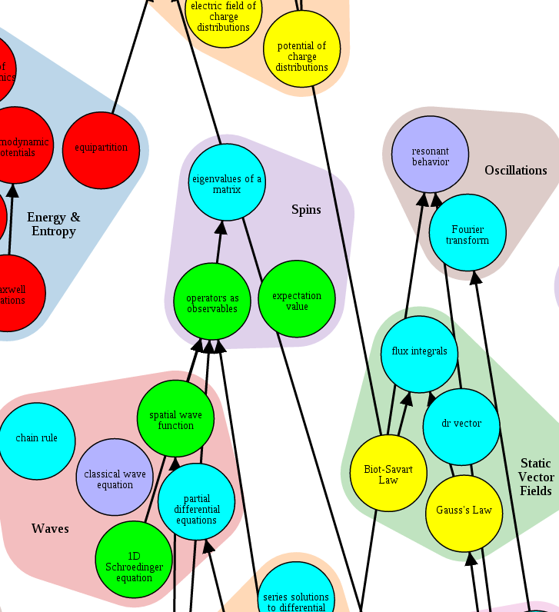
Dependencies

Slide 7
Daily Class Meetings
 | Monday | Tuesday | Wednesday | Thursday | Friday
12-1 pm
1-2 pm
Large Time Blocks

Slide 8
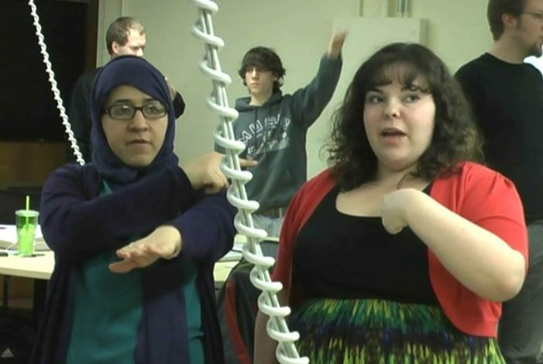
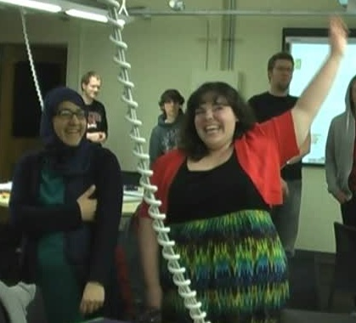

Active Engagement
Cohort Identity

Slide 9
What is the Paradigms?
Departmental Curriculum
Model Curriculum
/Planning Structure

Slide 10
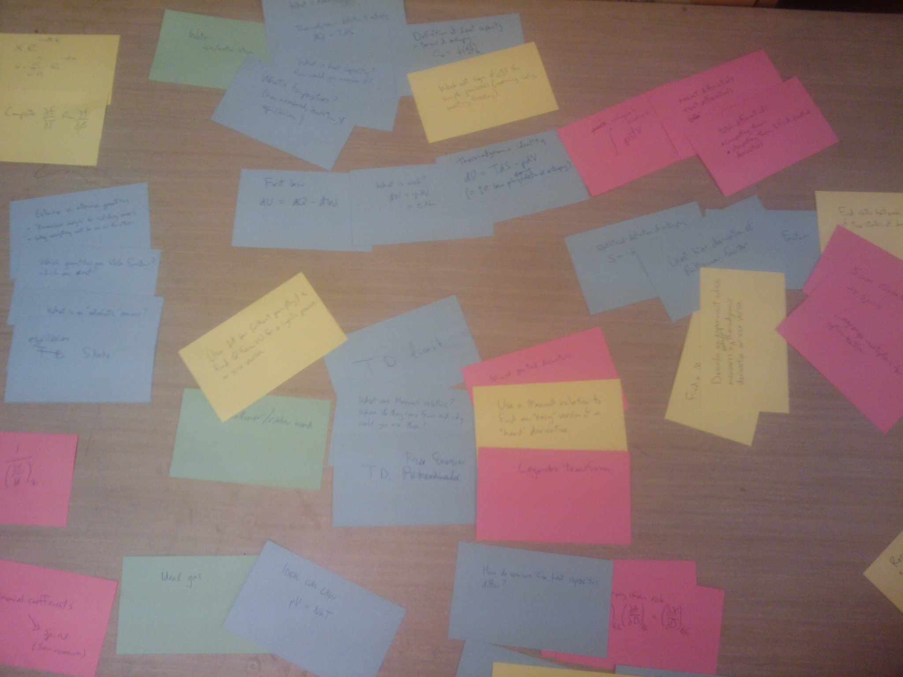
Card Sorting

Slide 11
Curriculum meetings
Shared Ownership
Culture of Iterative Improvement

Slide 12
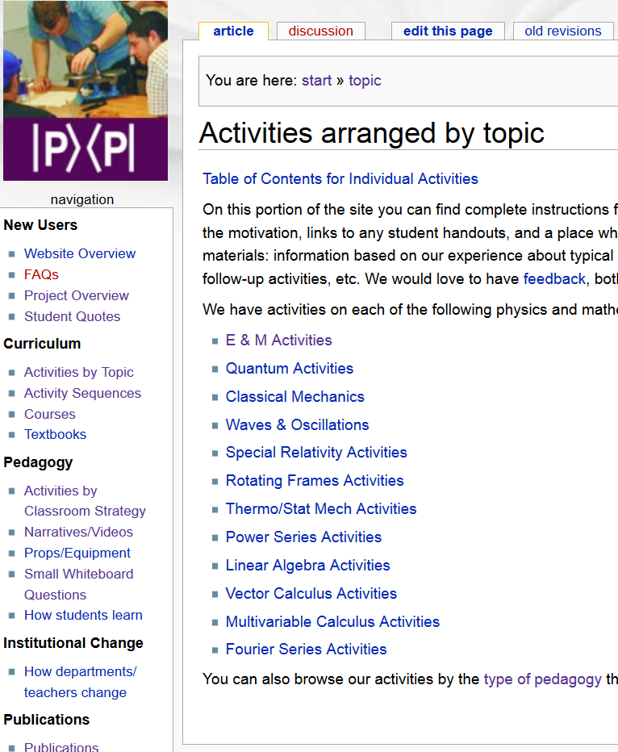
Centralized Documentation

Slide 13
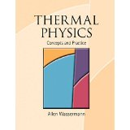


Textbooks/Workshops
Allen Wasserman
Thermal Physics:
Concepts and Practice
David McIntyre
Quantum Mechanics:
A Paradigms Approach
Tevian Dray
The Geometry of
Special Relativity

Slide 14
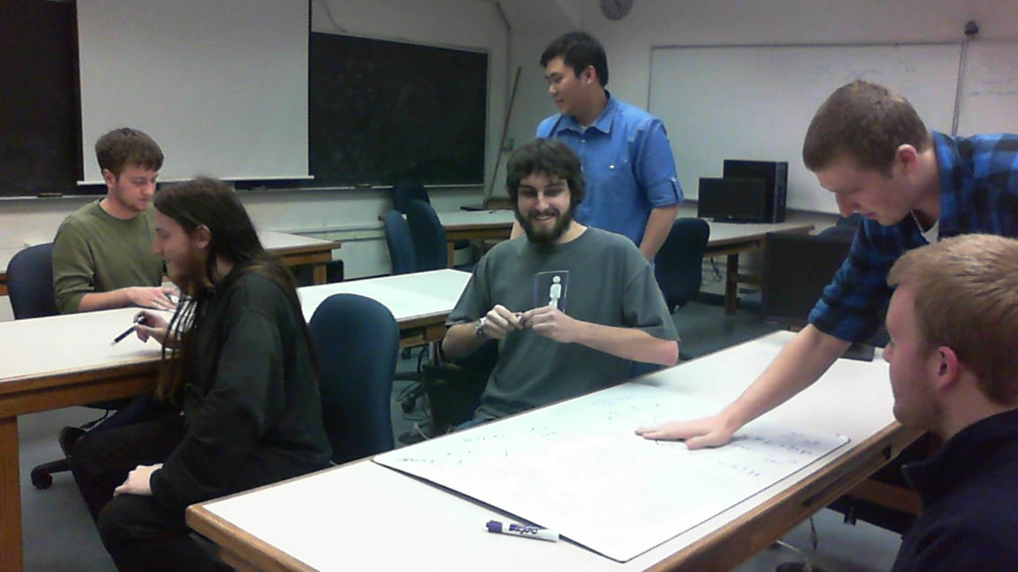
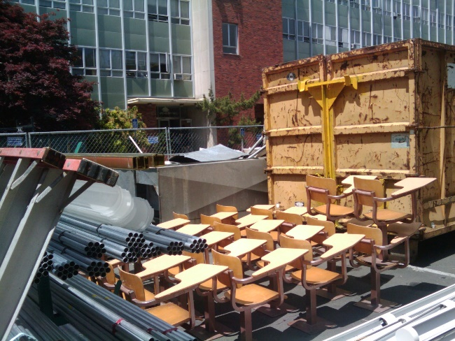
Classroom Remodel

Slide 15
Role of Chair
Foster an overall understanding of the curriculum.
Advocate with the administration.
Negotiate with Registrar.
Identify resources, esp. classroom space & remodel $$.
Make appropriate teaching assignments.
Value strong orientation toward teaching in the hiring and promotion processes.

Slide 16
Broader Impacts

Slide 17
University Recognition
Undergrad Review: The faculty is to be commended on the well-integrated, focused, collaborative culture that has been fostered. … This curriculum should be regarded as a major strength of the Department and a standard that other physics programs nationwide aspire to.
College of Science Strategic Plan: An NSF-funded Paradigms in Physics Program is a nationally recognized, innovative curriculum approach that teaches undergraduates to think like physicists and is regarded as a standard in physics education.
Teaching Awards: CAM, JT, TD, Paradigms TAs

Slide 18


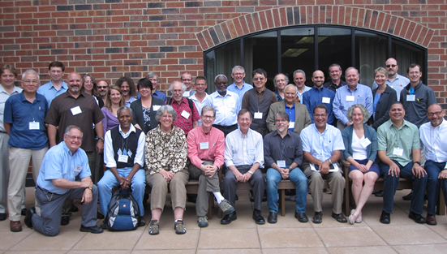
National Recognition

Slide 19
DBER Funding in PH
$2.8 M Paradigms (12)
$2.7 M Science Accessibility (4)
$2.6 M Teacher Preparation (6)
$2.1 M Lower-Division Reform (7)
$0.8 M Computational (6)
$0.8 M Graduate Preparation (3)
$0.4 M Undergraduate Laboratories (2)
$0.3 M Undergraduate Programs (2)
$0.1 M Women in Physics (2)
$12.8M Total

Slide 20
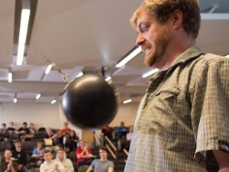
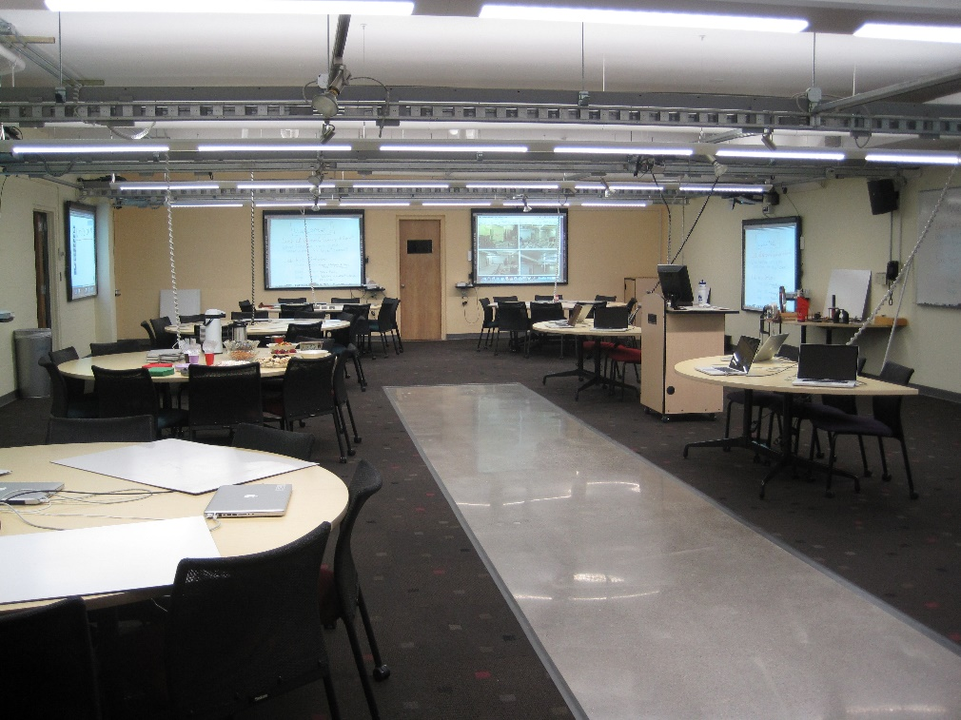
Lower-Division
Reform
ESTEME
@OSU

Slide 21
What is the Paradigms?
Departmental Curriculum
Model Curriculum
/Planning Structure
PER Laboratory

Slide 22
Curriculum development
Student difficulties
Research Opportunities

Slide 23
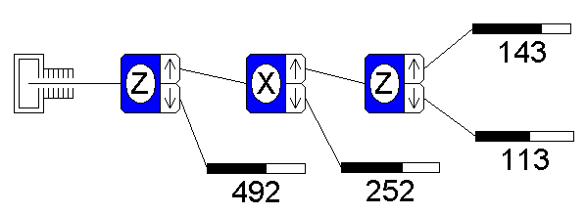
Stern-Gerlach
The Spins course, developed by David McIntyre, uses a simulation of successive Stern-Gerlach apparati.

Slide 24
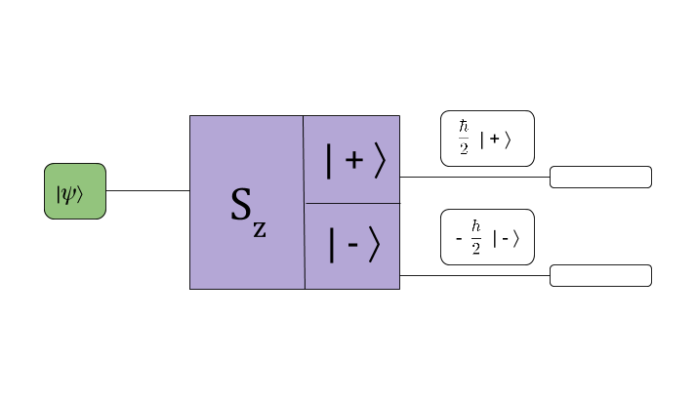
Quantum Operators
E. Gire & C. Manogue, PERC 2011

Slide 25
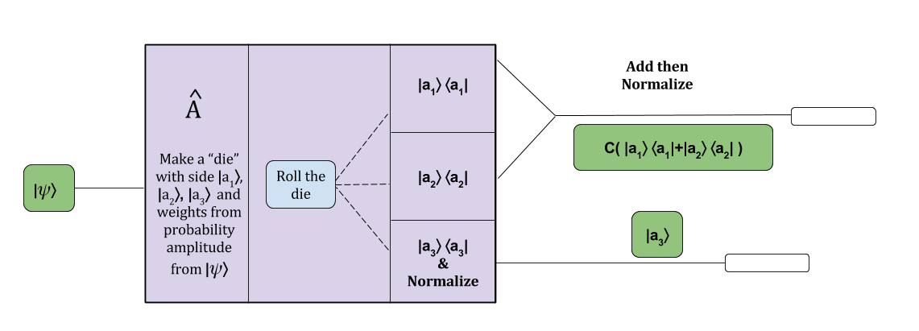
Allegory
Use a whole class kinesthetic activity to tell the allegorical story of what happens inside the Stern-Gerlach machine.

Slide 26
Name the Experiment
Draw an experiment that would represent the following measurements:
D. Roundy et al., AJP 2014

Slide 27
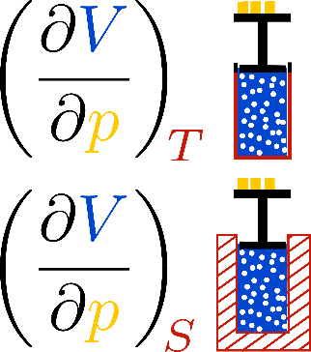
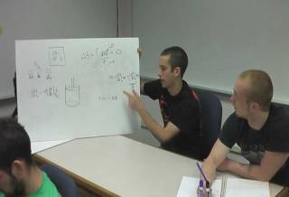
Name the Experiment

Slide 28
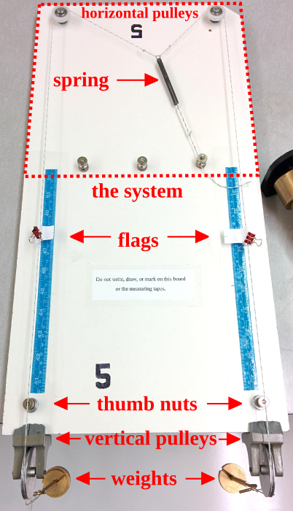
Partial
Derivatives
Machine
8 papers
$.65 M

Slide 29









Partners
California State, San Marcos
DePaul University
University of Maine
Missouri Southern State
LBCC
Saint Mary’s Univ.
Virginia Tech
Winona State
Xavier University

Slide 30
What is Paradigms
2.0?
Departmental Curriculum
Model Curriculum
/Planning Structure
PER Laboratory

Slide 31
History—EvZ
This is the story of a faculty’s decision, about twenty years ago, to radically modify the content, timing, pedagogical approach, setting, student population, and underlying philosophy of their upper-level physics program.
Data
  Interviews with faculty, TAs, students, evaluator
  Journal articles, PI report to faculty, NSF reports, evaluator reports

Slide 32
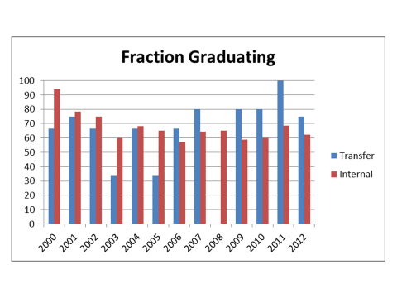
Use New Data—HJ, LG

Slide 33
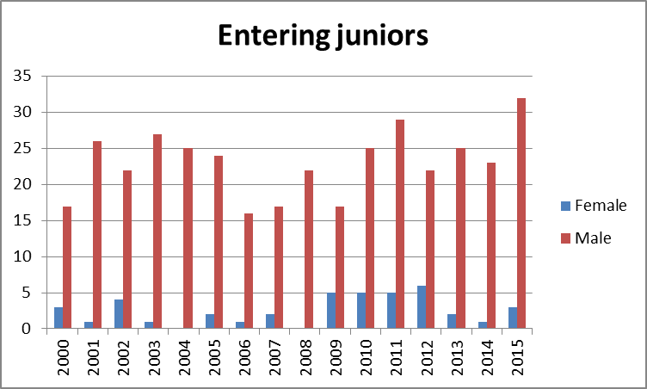
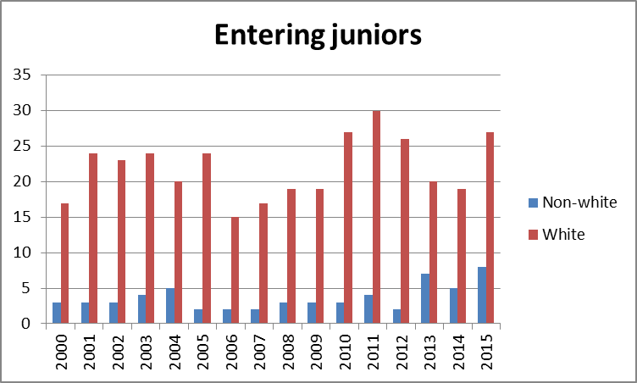

Slide 34
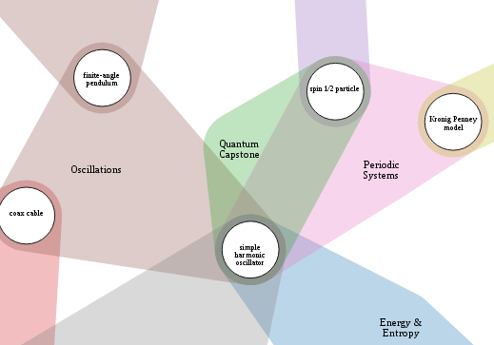
Multi-faceted High-tech
Card Sorting—DR, CAM, LG, EM

Slide 35
Changes to scope
Role of:
  Modern,
  Computational,
  electronics,
  thesis,
  sophomore experience,
  specialty courses
Pressure on junior year
GRE prep
Thesis prep

Slide 36
New Curriculum
? ? ? ? ? ? ?
Junior Year Fall |  |  | Winter |  |  | Spring |  |  | Senior Year
320 Symmetries | 422 Vector Fields | 421 Oscillations |  |  |  |  | 429 Reference Frames |  | 431 Electromagnetism
 |  |  |  | 424 1-D Waves | 427 Periodic Systems |  |  | 426 Central Forces | 435 Classical Mechanics
 |  |  | 425 Spins |  |  | 423 Energy & Entropy |  |  | (Mathematical Methods)
 |  |  |  |  |  |  |  |  | 451 Quantum Mechanics
 |  |  |  |  |  |  |  |  | 441 Statistical Physics
411-412 Electronics |  |  |  |  |  | 461 Math Methods |  |  | 481 Optics
265, 36x, 415 Computational Physics/Computer Interfacing |  |  |  |  |  |  |  |  | 403 Thesis
? ? ? ? ? ? ?
?

Slide 37
Maintenance
Curriculum group membership and functioning
Information for local adopters
Dissemination of research results
Assessment plan
Data plan

Slide 38
Student Success Initiative
—President Ray
By 2020:
affordable
school of choice
all students achieve success regardless of …
first-year retention from 83.8 % to 90 %
six-year graduation from 63% to 70 %

Slide 39
NSF—IUSE
… the National Science Foundation invests in evidence-based and evidence-generating approaches to understanding STEM learning; to designing, testing, and studying instruction and curricular change; to wide dissemination and implementation of best practices; and to broadening participation of individuals and institutions in STEM fields.

Slide 40
Paradigms 2.0 Timeline
Winter 2016:
Colloquium/Survey
Survey analysis/make cards
Spring 2016:
Card sorting
Discussions w/ everyone
Faculty vote
Summer 2016->Spring 2018:
Apply for funding?
Category II proposals
Implement/document new curriculum/strategies

Slide 41
Role of Chair
Foster an overall understanding of the curriculum.
Advocate with the administration.
Negotiate with Registrar.
Identify resources, esp. classroom space & remodel $$.
Make appropriate teaching assignments.
Value strong orientation toward teaching in the hiring and promotion processes.

Slide 42
Needed from YOU
Complete the Qualtrics survey
Read EvZ’s History Summary —Many thanks to those who contributed!
Read other information at:
physics.oregonstate.edu/paradigms2
Participate as a member of your curriculum group, research group, student focus group
Give feedback early and often
(EvZ is the Anonymizer)
VOTE

Slide 43
Survey Instructions
Follow link in e-mail invitation to Qualtrics survey
To save incomplete survey - enable browser cookies (same browser, same computer)
Paper version may be provided on request to EvZ
Complete by Monday, 2/22

