Slide 1
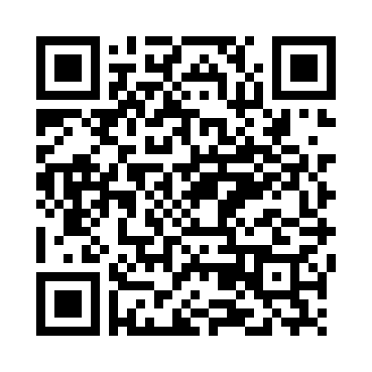
osuastronomyclub.wordpress.com/
http://blogs.oregonstate.edu/phis/
https://physics.oregonstate.edu/society-physics-students
OSU Department of Physics Astronomy Open House
osuastroclub@gmail.com
OSU Physicists for Inclusion
in Science
osu_phis
Society of Physics Students
(Oregon State University)
President: Dustin Treece treecedu@oregonstate.edu
Join the PhIS
mailing list

