Slide 1
pagone@uchicago.edu
Physics Careers
Making a Splash in the Job Market
Crystal Bailey, PhD American Physical Society

Slide 2
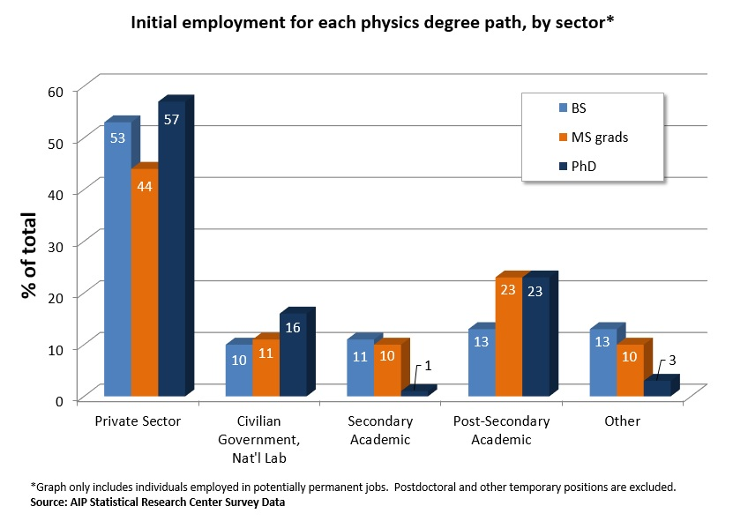
Some Statistics: Where Physicists Work
Private Sector
BS: comp. science and engineering, teamwork
MS: management, some research
PhDs: scientific research, product development
Academic Sector
BS: primarily high school teaching
MS: lab coordinators, HS and college teaching
PhDs: permanent professors
National Lab/Government
BS: technician, assisting users
MS: management of instrument teams, patent work, engineering
PhDs: senior research staff, oversee large operations

Slide 3
Physics Workforce Summary
Faculty positions are NOT the most common career path for physicists!
Industry is the largest employment base for Physics PhDs…
…and for Physics Masters
….and Physics Bachelors.
You can find a career which aligns not only with your interests, but also your values, by keeping your mind and eyes open!
There is a lot of great science to be done and opportunity to be found— in a lot of different places!

Slide 4
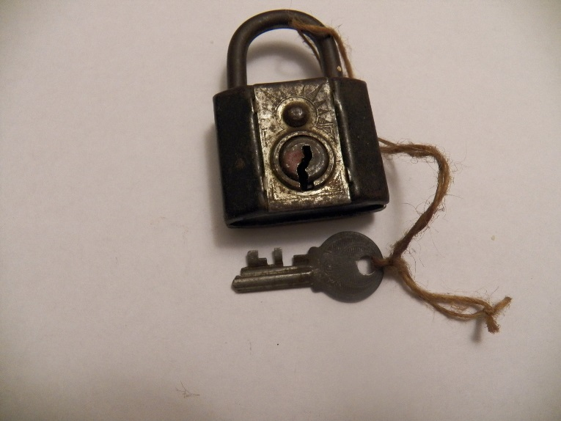
Careers: A Broad View
A successful career means building connections between:
Skills Sets Does your skill set match the skill set needed for the job?
Interests Will you find this job intellectually stimulating and/or rewarding?
Values Is this job a good match your future lifestyle goals? or, Are the differences something you can reasonably adjust to?
A detailed self-assessment of skills and values is what will help you achieve the perfect fit.

Slide 5
Activity: Future Career Goals – 5 min.
Compose a List of Your Career Goals/Values
Doing interesting research
Making a difference in people’s lives
Having a flexible schedule
Working with other people
Having a well-defined work schedule
Making MONEY!!!
Compose a List of Future Job Titles
Graduate Researcher
Postdoc Researcher
Professor
National Lab Scientist
High School Teacher
Community College Teacher
Entrepreneur
Lab Director

Slide 6
Graduate Researcher?
Physics Teacher?
Enjoys building things in lab
Works hard, self-motivated
Likes being creative
Comfortable taking risks
Enjoys being a leader
Wants to make BIG money
Entrepreneur? Director of a Science Center?
Finds science interesting
Enjoys explaining concepts
Confident being social
Enjoys talking to people
Is persuasive
LOVES to travel
Sales and Marketing? Technical Consultant?
Many careers will match your talents, values and abilities.
The first step is knowing YOURSELF, before you decide which careers to further explore.
Strong® Interest Inventory
Myers-Briggs® Personality Test
These tests are often available FREE, or at minimal cost, from Campus Career Services!!

Slide 7
Informational Interviews
Making the connection means understanding not only your values and interests, but also the jobs. Informational interviews are your secret weapon.
30-minutes
talk to a person from an industry or company of interest
you ask the questions!
Getting informational interviews is easier than you think!
Networks (Alumni, Prof. Societies)
LinkedIn®

Slide 8
Activity: Using LinkedIn®
Most (80%) of people get their jobs through 2nd degree connections.
LinkedIn® is your #1 tool in discovering new connections and new opportunities.
Homework:
Complete your LinkedIn profile at this conference
Picture!!!
Educational Information (e.g. high school, college)
Transferrable Skills (volunteering experience, research, hobbies, etc.)
Connect with 10 individuals at this conference!!
Other Students
Organizers
Speakers

Slide 9
Lost in Translation: Communicating your Skills Effectively
#1 Mistake Made by Physicists: Focusing on Labels Rather than Skills

Slide 10
Resume Writing: Three Step Process
Understand the skills the job requires
Hint: this means actually reading the job description!
Assess honestly whether or not you have those skills, or whether you are genuinely interested in building them.
Connect the dots in your resume—focus on SKILLS, NOT ON LABELS!
Skills Based Resume
Cover Letter
CVs versus Resumes
NOT interchangeable!!!
Resumes no longer than one page.
Expect to write a unique resume for every single position you apply for.

Slide 11
Jane Q. Public
1234 Maple Lane
Anywhere, OH 99934
Research Objective
To understand the basic principles behind everyday phenomena, and most importantly, get a job.
Education
BS, Physics, Greenleaf University, 1995
MS, Physics, University of South Whales, 1997
PhD, Physics, University of South Whales, 2001
Work Experience
Postdoctoral Fellow, Department of Physics, U. of New South Whales, 2008-present
Postdoctoral Fellow, Department of Physics, U. of New South Whales, 2006-2008
Postdoctoral Fellow, Department of Physics, New South Whales, 2004-2006
Research Assistant, Department of Physics, New South Whales, 1998-2004
Publications
A Measurement of Optical Scattering of Light Waves from Atmospheric Molecules (Journal of Obvious Science, Volume 6012, 2002.)
Presentations
My bologna has a first name, it’s OSCAR (44th Annual Meeting of the American Association of Physics of Food Service Society, 2003)
My bologna has a second name, it’s MAYER (Section Meeting of the Society for
Instrument Design Engineer/Scientist
Location: California
Salary: 60K – 120K
Job Description:
The successful applicant will lead a new instrument team, and will have experience in microcontrollers, data acquisition, analog and digital signal processing, and algorithm design.
Ability to read schematics is also a plus. Candidates should also have strong written and oral communication skills, and should be comfortable in a leadership position and working with a team.
Not to mention developing and leading a highly successful outreach program to local high schools, in her spare time.
She also wrote a data analysis program that is an essential piece of software in her group to this day.
Is this a good fit?
Jane designed and built the entire electronic data acquisition system for her experiment.

Slide 12
Jane Q. Public
1234 Maple Lane
Anywhere, OH 99934
Data Acquisition Experience
Designed and built sensors and electronic data acquisition system for light level measurement (Research Assistant, University of S. Whales, 1998-2001).
Devised novel noise-reduction techniques to isolate and remove background (Research Assistant, University of S. Whales, 1998-2001).
Software Design Experience
Wrote analysis software using C++ and IDL, still in use by the research group (Postdoctoral Fellow, University of S. Whales, 2004-2006).
Leadership Experience
Developed and led a science outreach effort to local high schools. (Postdoctoral Fellow, University of S. Whales, 2006-present).
Education
BS, Physics, Greenleaf University, 1995
MS, Physics, University of South Whales, 1997
PhD, Physics, University of South Whales, 2001
Leadership/Service
Teaching Experience
Etc.
Let’s Try That Again…with a Skills Based Resume
Instrument Design Engineer/Scientist
Location: California
Salary: 60K – 120K
Job Description:
The successful applicant will lead a new instrument team, and will have experience in microcontrollers, data acquisition, analog and digital signal processing, and algorithm design.
Ability to read schematics is also a plus. Candidates should also have strong written and oral communication skills, and should be comfortable in a leadership position and working with a team.
Sounds like a great fit! Let’s get her in for an interview.

Slide 13
Activity: Assessing Transferrable Skills
5 minutes- Identify Transferrable Skills (not just technical skills!!)
Created device controller using LabView
Designed, built and tested new electrical component for experiment
Used oscilloscope to isolate and minimize RF noise in circuits
Built components using a drill press, lathe, band saw, etc.
Worked with course leader to develop new intro physics curriculum
Volunteered to do outreach in your community
Speaks three languages fluently
Etc.

Slide 14
Based on your list, select one of the following job descriptions, downloaded from the APS Job Board (careers.aps.org)
Diagnostic Physicist/Specialist
Physics Assistant
Sr. Cryogenic Laboratory Technician
Satellite Laser Ranging Research Geophysicist
Registration Manager

Slide 15
Now use your listing to create a “group resume” for your job description
Word bullet points in the active voice, e.g. “Designed,” “Developed,” “Manufactured.”
Avoid repeating verbs—mix it up.
Group bulleted skills under common categories, e.g. “Analytical Skills”, “Leadership Skills,” etc.
Follow each bulleted item with (your title, the institution, and the relevant dates)
Continue to add to your stash of resume “building blocks!” Keep a Careers Journal and Write Regularly!

Slide 16
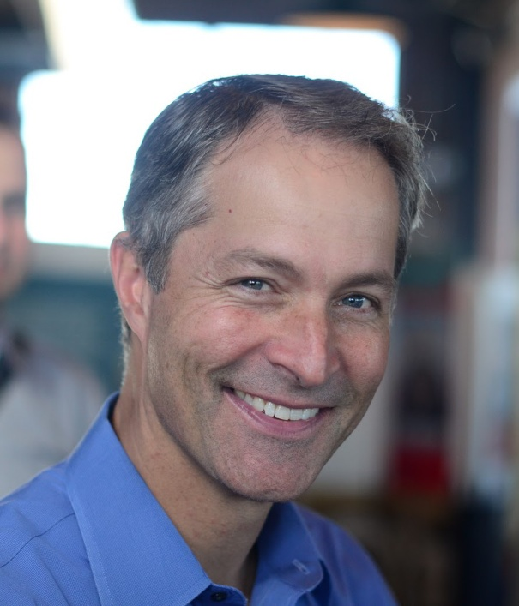
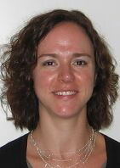
What’s Next?
If your resume does its job, you’ll soon be faced with other questions like:
Interviewing
How do I prepare myself? What can I expect?
Negotiation
Should I negotiate my offer? What strategies can I use?
Following Up
What are the standard practices? What if I don’t receive an offer?
APS Online Professional Guidebook
Features 5-minute “webinette” clips from the top APS careers webinars
APS webinar “Putting Your Science to Work,” with Peter Fiske
APS webinar “Career Self-Advocacy: How I Got A Six Figure Job in the Private Sector,” with Meghan Anzelc
Topics include self-assessment, networking, interviewing and negotiation strategies, and more.
http://go.aps.org/physicspdguide

Slide 17
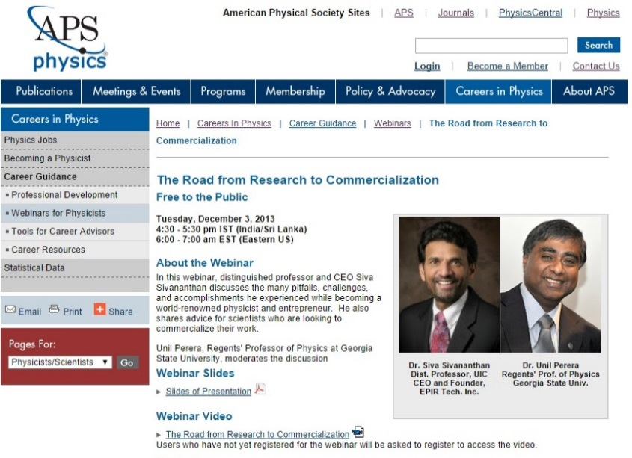
APS Careers Website
Library of Physicist Profiles
Advice from physicists representing a diversity of degree paths and careers
Job Prospects Pages
Profiles feature the most common career paths for physicists
Includes day to day activities, additional skills and training needed, salary information, job outlooks
Physics Employment and Salary Information
Clearing house for most recent physics employment data from AIP SRC
Thumbnails and links to full reports for more information
APS Webinars Archive
On-demand viewing for all webinar presentations

Slide 18
Thank you! bailey@aps.org
Remember:
Plan Effectively by Broadening Your Focus
Use your resources to explore your career values and learn about career paths outside of academic physics.
Focus on Skills, Not on Labels
Use skills-based resumes and cover letters to connect the dots between the job description and your skill set.
Visit the APS Online Professional Development Guide and the Careers Website

